Slide 1

Scheduling and Analysis of Limited-Preemptive Moldable Gang Tasks Weekly Meeting
Joan Marcè i Igual
18th of March, 2020

Slide 2
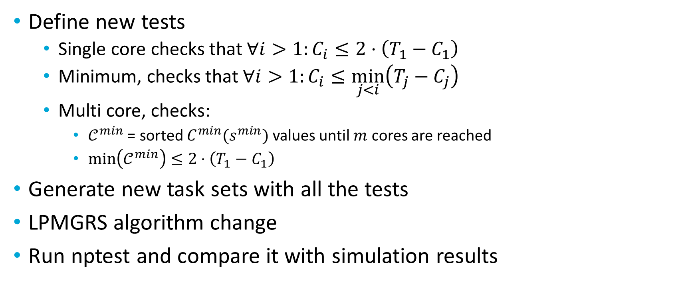
What has been done?
Define new tests
Single core checks that $∀i>1:C_{i}≤2⋅\left(T_{1}−C_{1}\right)$
Minimum, checks that $∀i>1:C_{i}≤\min_{j<i}\left(T_{j}−C_{j}\right)$
Multi core, checks:
$𝒞^{min}$ = sorted $C^{min}(s^{min})$ values until $m$ cores are reached
$min\left(𝒞^{min}\right)≤2⋅\left(T_{1}−C_{1}\right)$
Generate new task sets with all the tests
LPMGRS algorithm change
Run nptest and compare it with simulation results
Notes:
First of all, let’s explain what gang scheduling is.
<click>
Let’s say that we have multiple threads that we want to schedule. If we want to convert them to a gang task we would put them together as a “gang” <click> and then we would schedule as a single task<click> so the execution would not start until there are enough free cores.

Slide 3
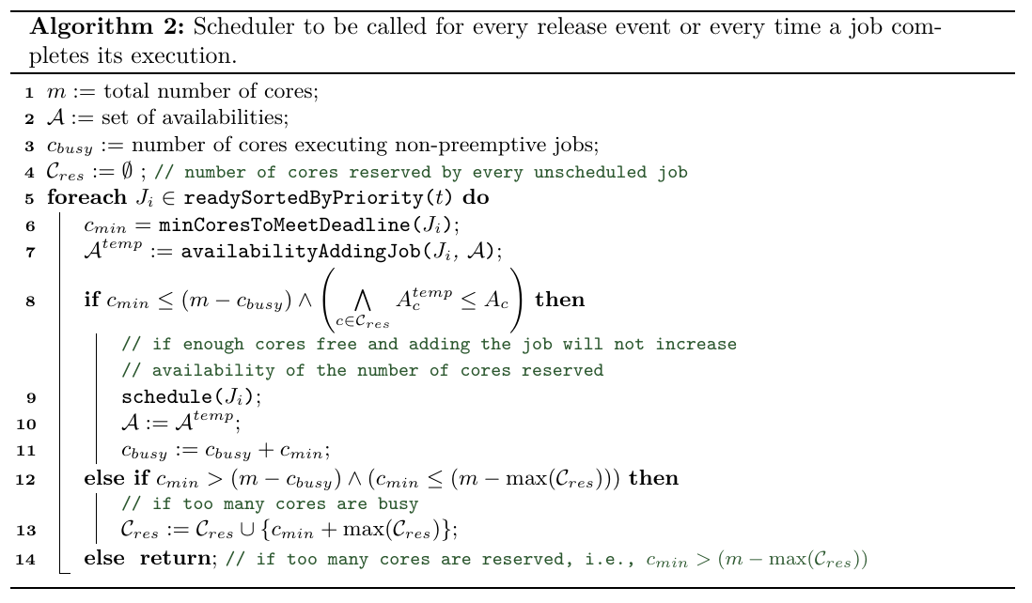
Algorithm change

Slide 4
What has been done?
Define new tests
Single core checks that $∀i>1:C_{i}≤2⋅\left(T_{1}−C_{1}\right)$
Minimum, checks that $∀i>1:C_{i}≤\min_{j<i}\left(T_{j}−C_{j}\right)$
Multi core, checks:
$𝒞^{min}$ = sorted $C^{min}(s^{min})$ values until $m$ cores are reached
$min\left(𝒞^{min}\right)≤2⋅\left(T_{1}−C_{1}\right)$
Generate new task sets with all the tests
LPMGRS algorithm change
Run nptest and compare it with simulation results
Notes:
First of all, let’s explain what gang scheduling is.
<click>
Let’s say that we have multiple threads that we want to schedule. If we want to convert them to a gang task we would put them together as a “gang” <click> and then we would schedule as a single task<click> so the execution would not start until there are enough free cores.

Slide 5
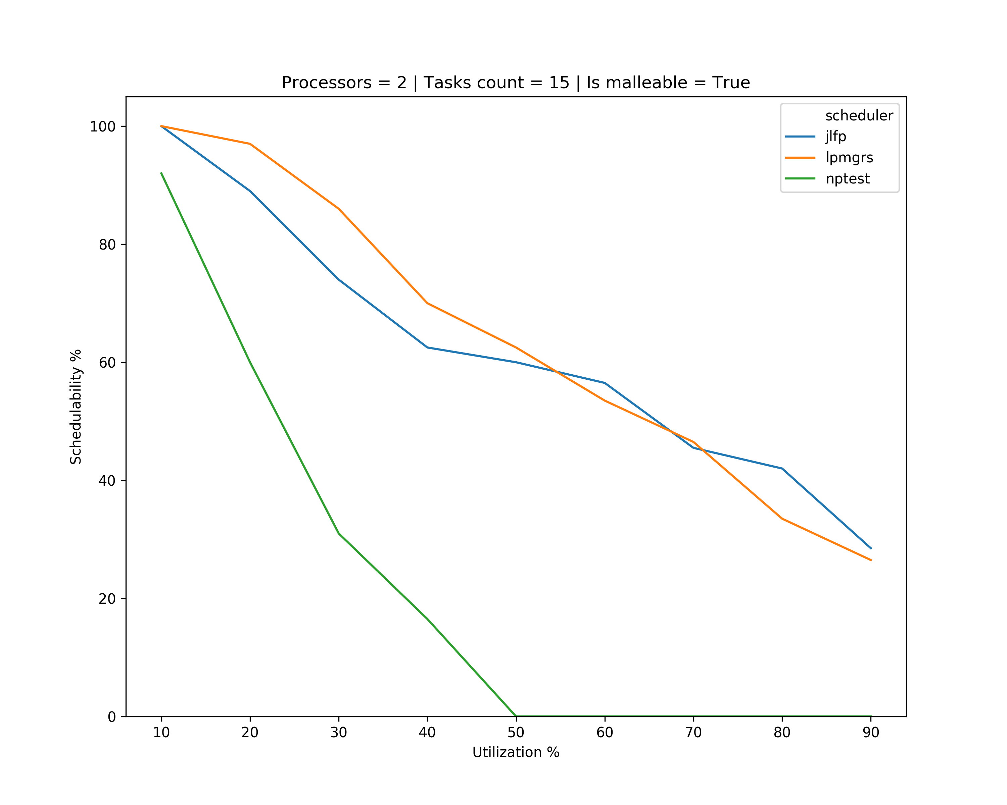
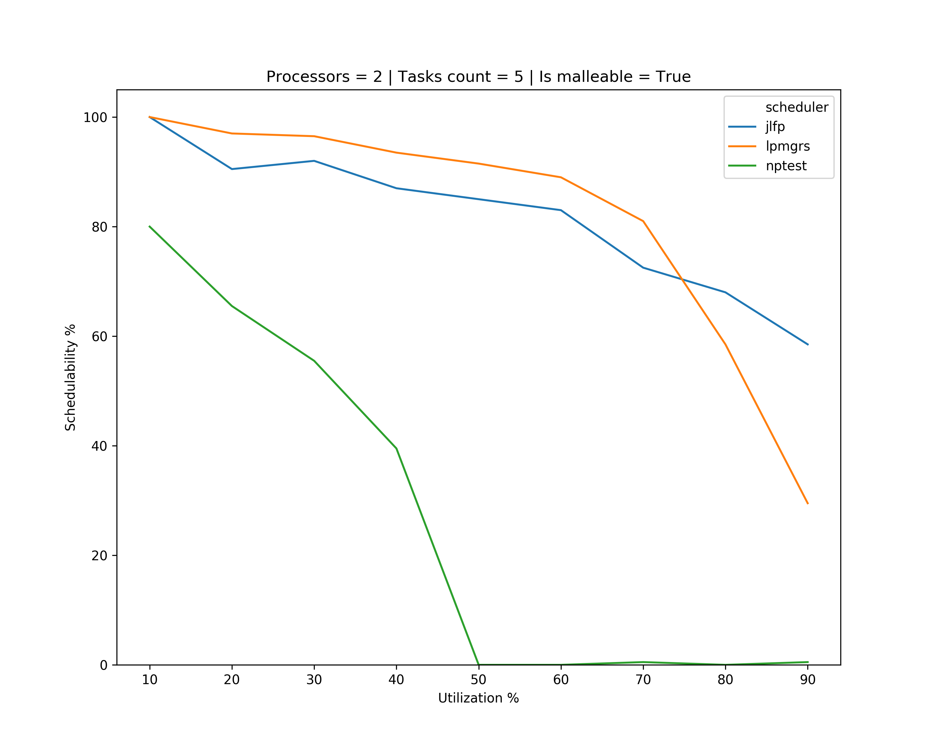
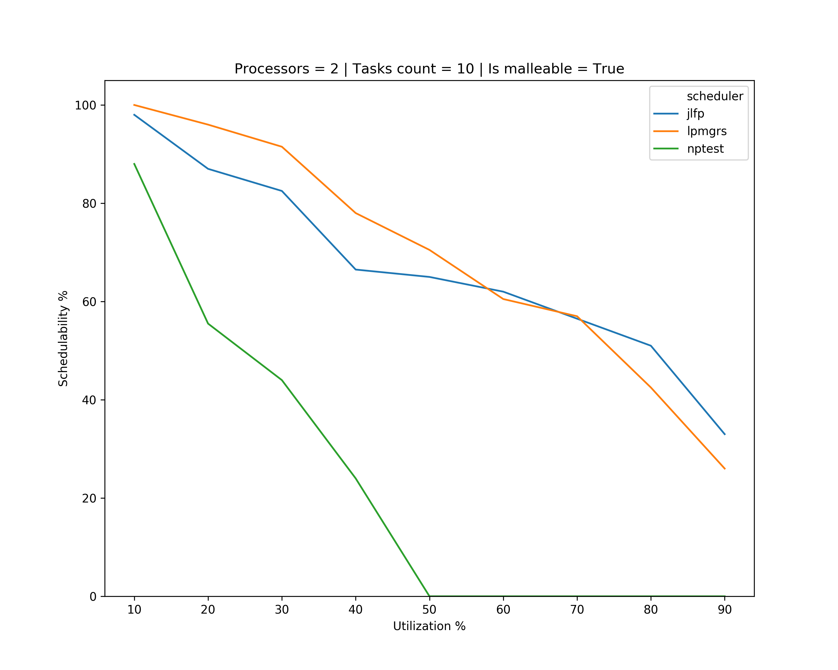
Results – single core

Slide 6
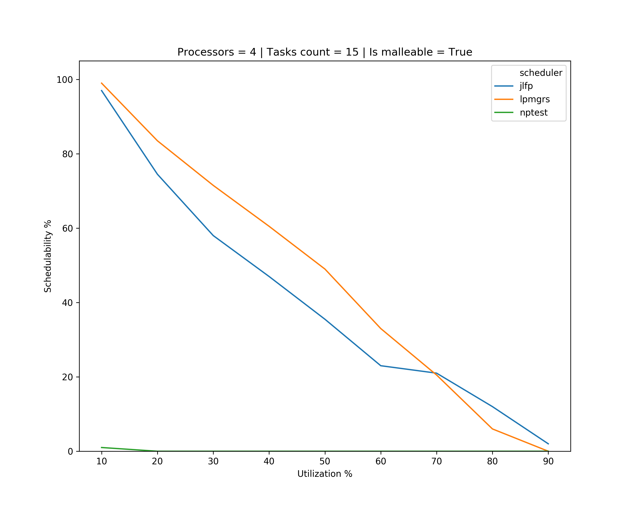
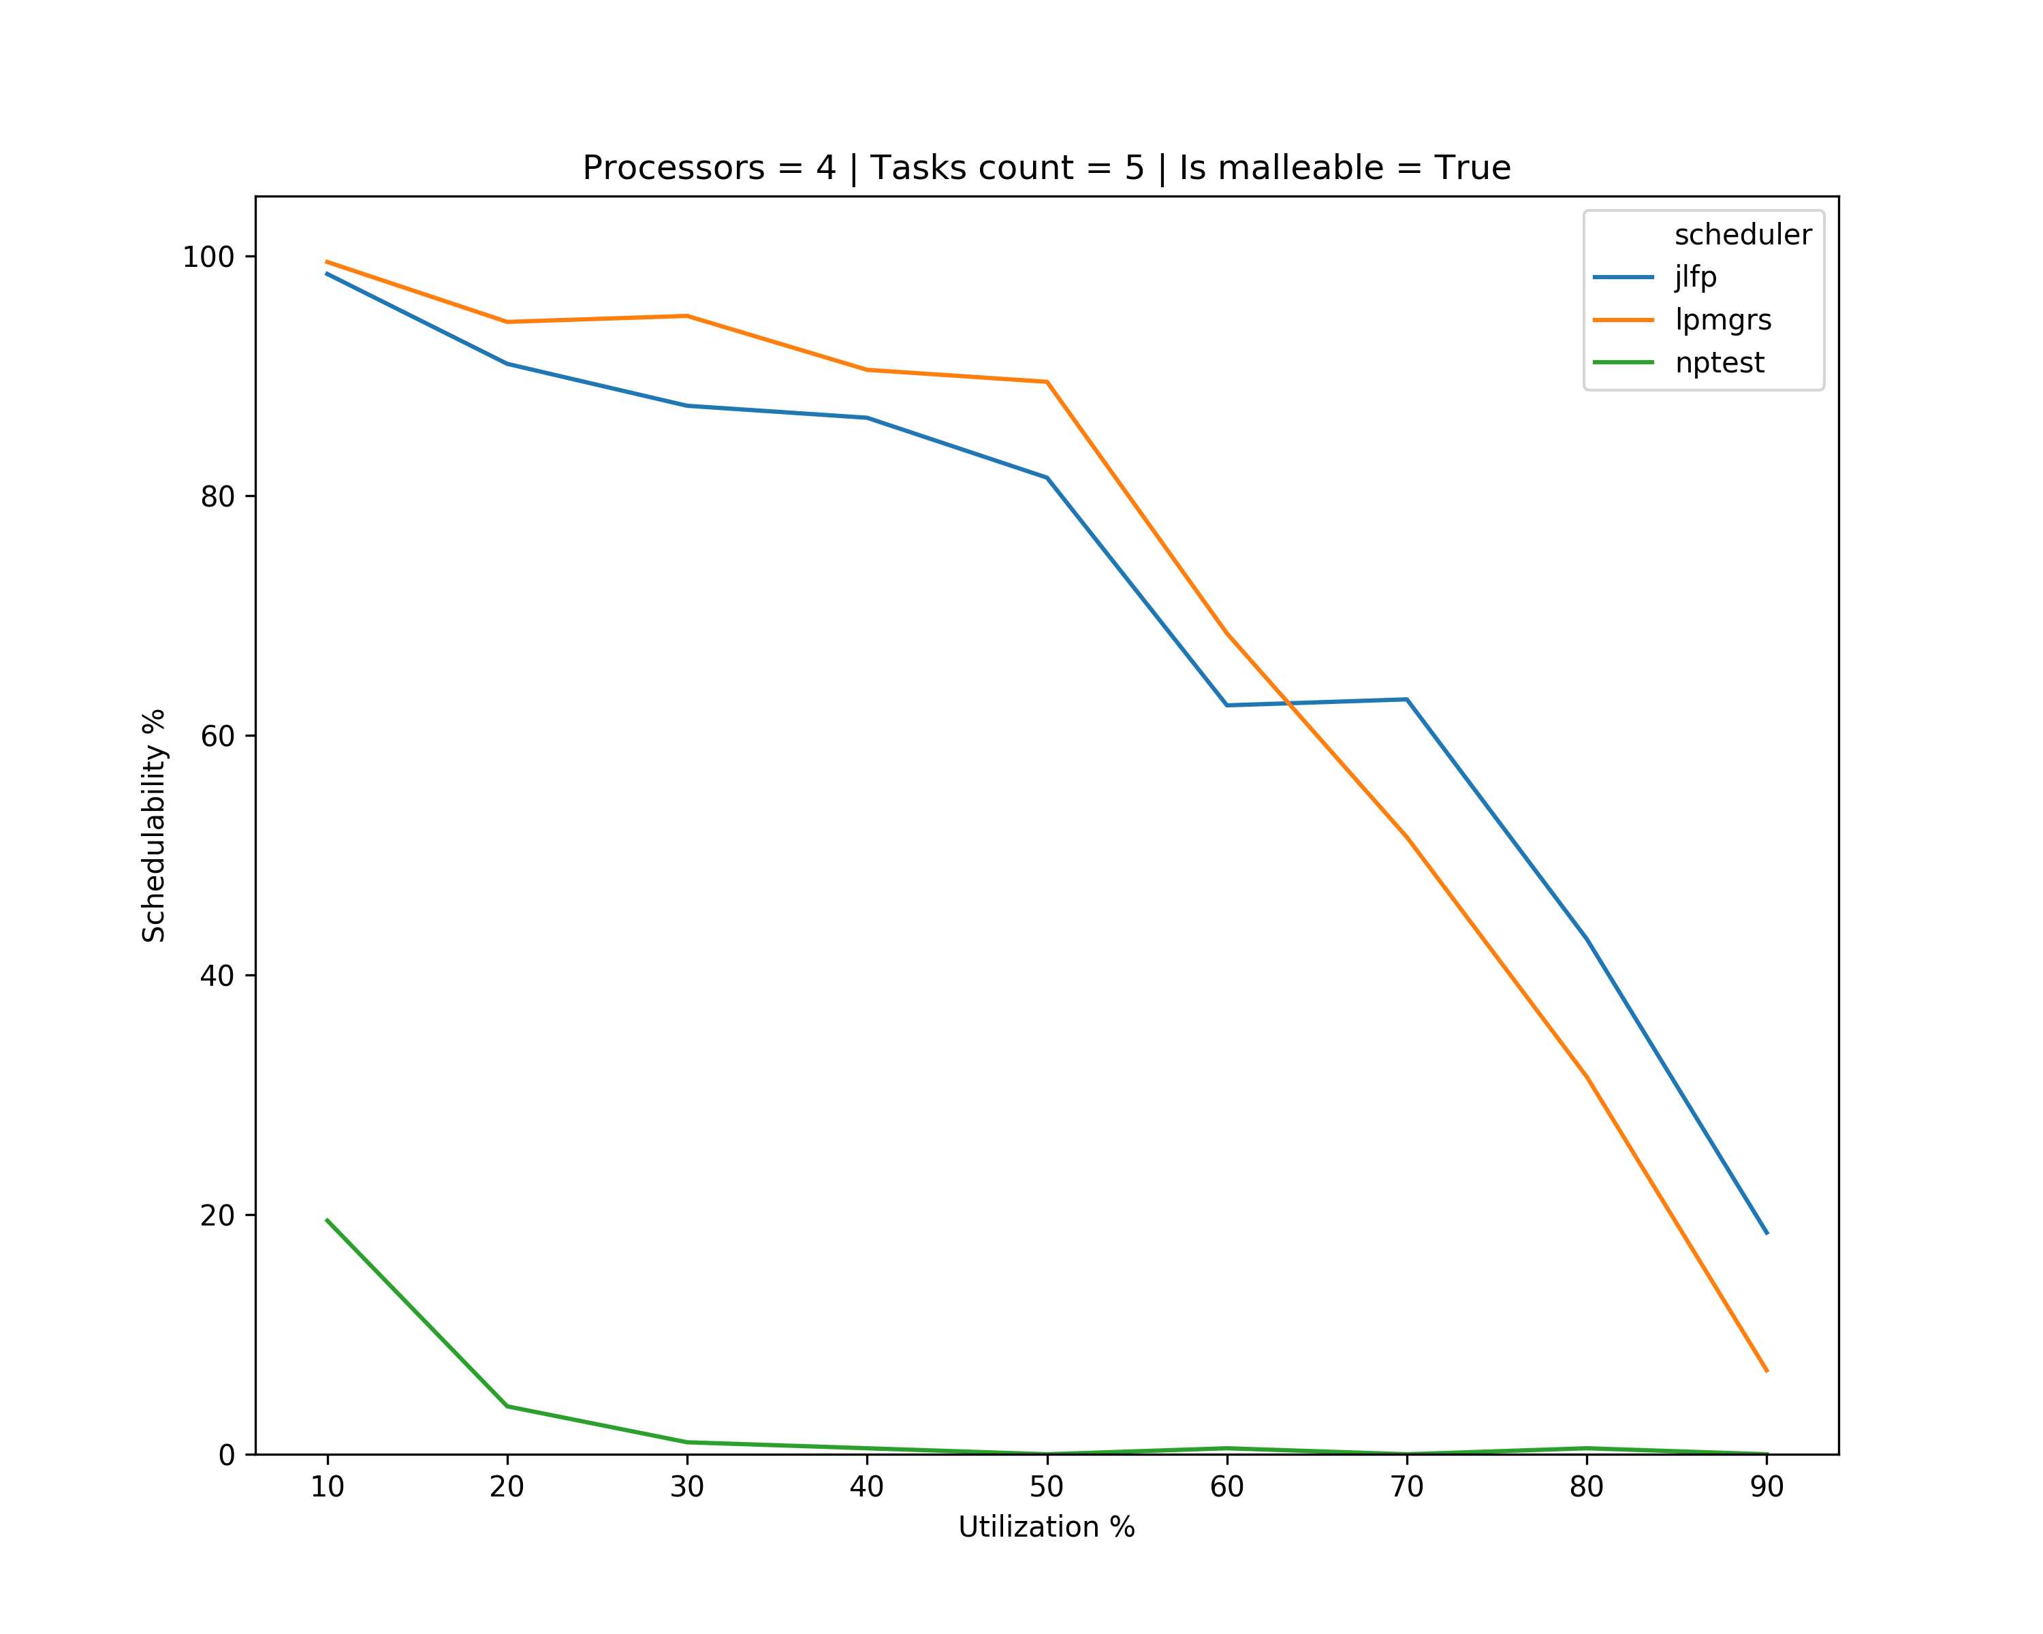
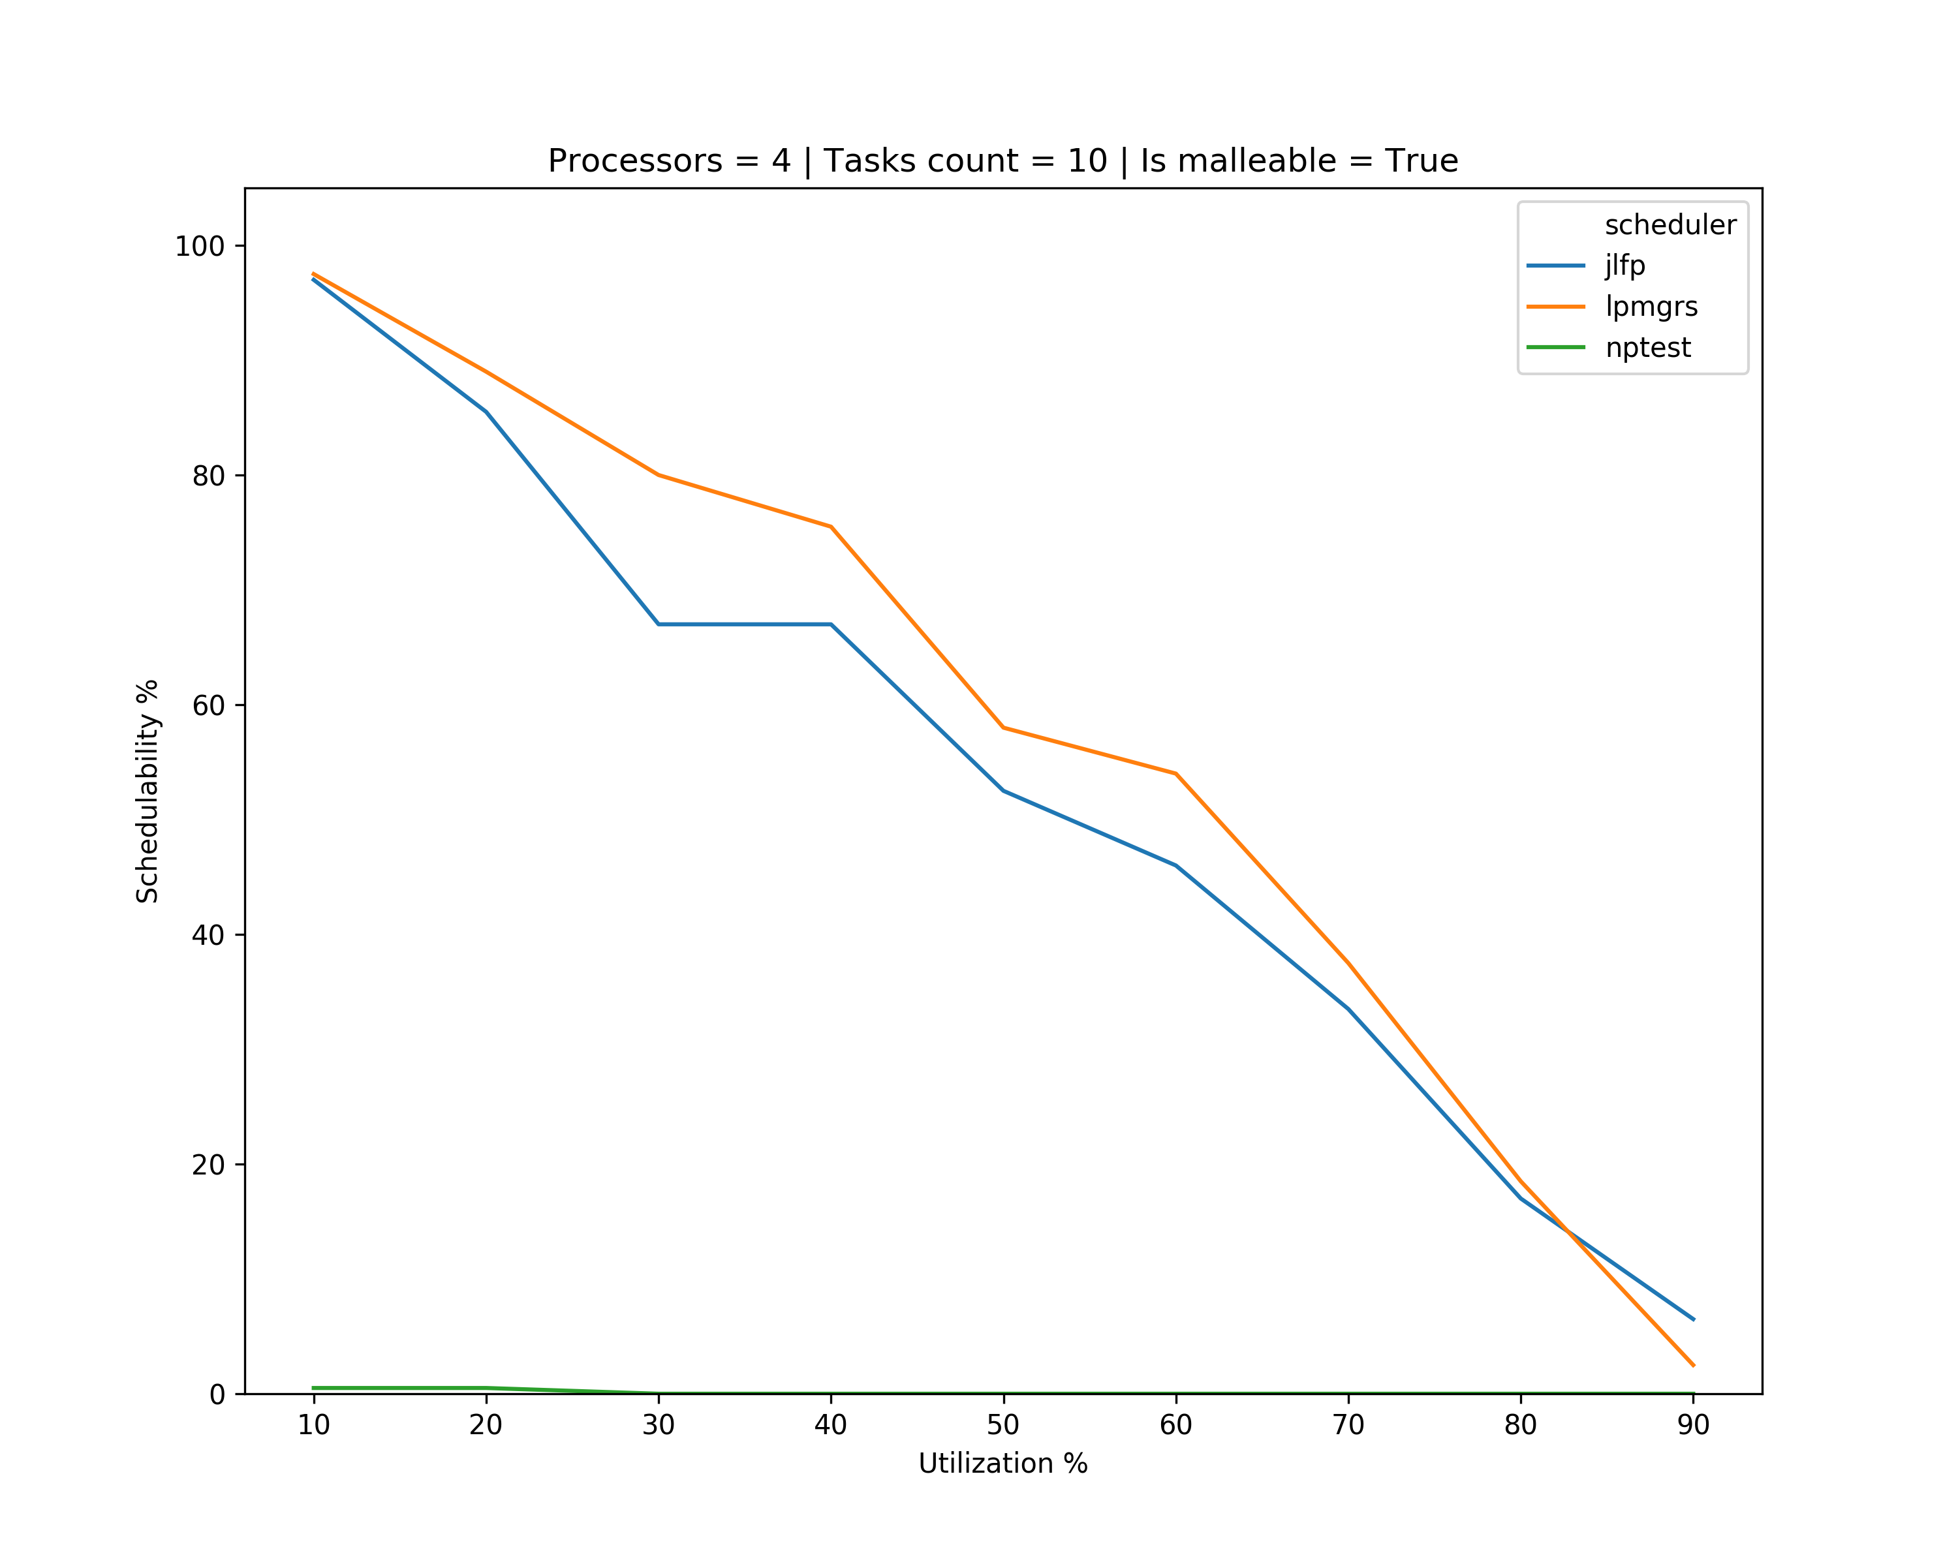
Results – single core

Slide 7
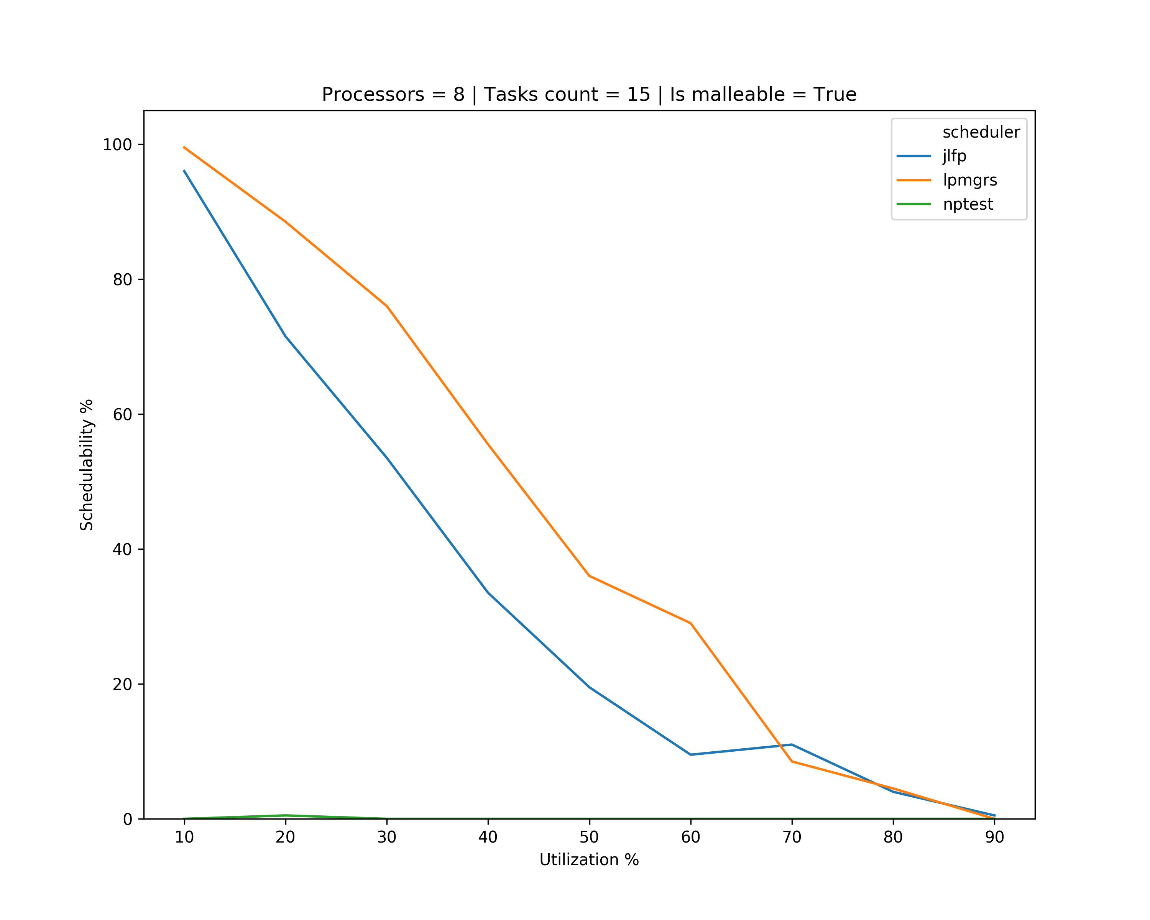
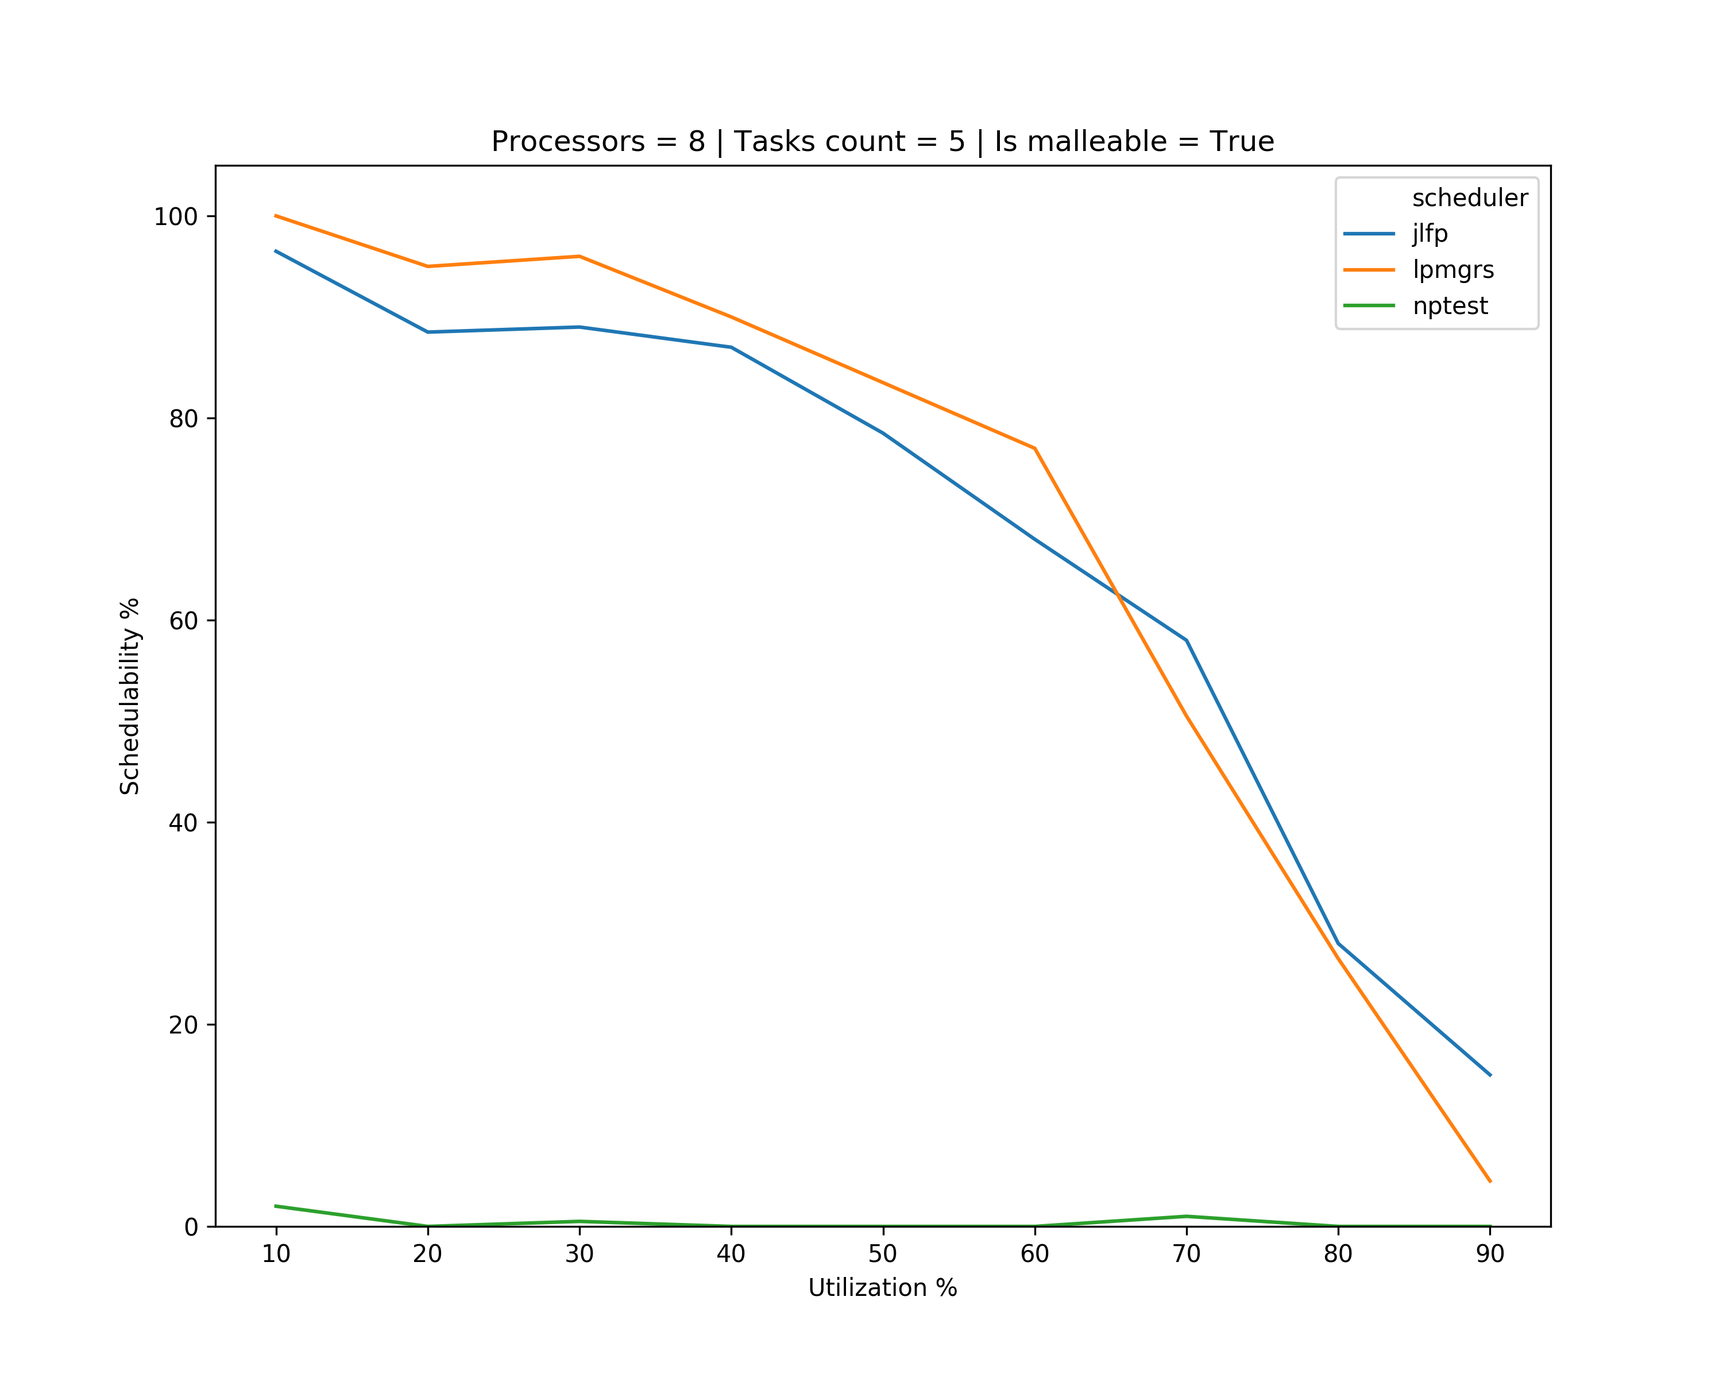
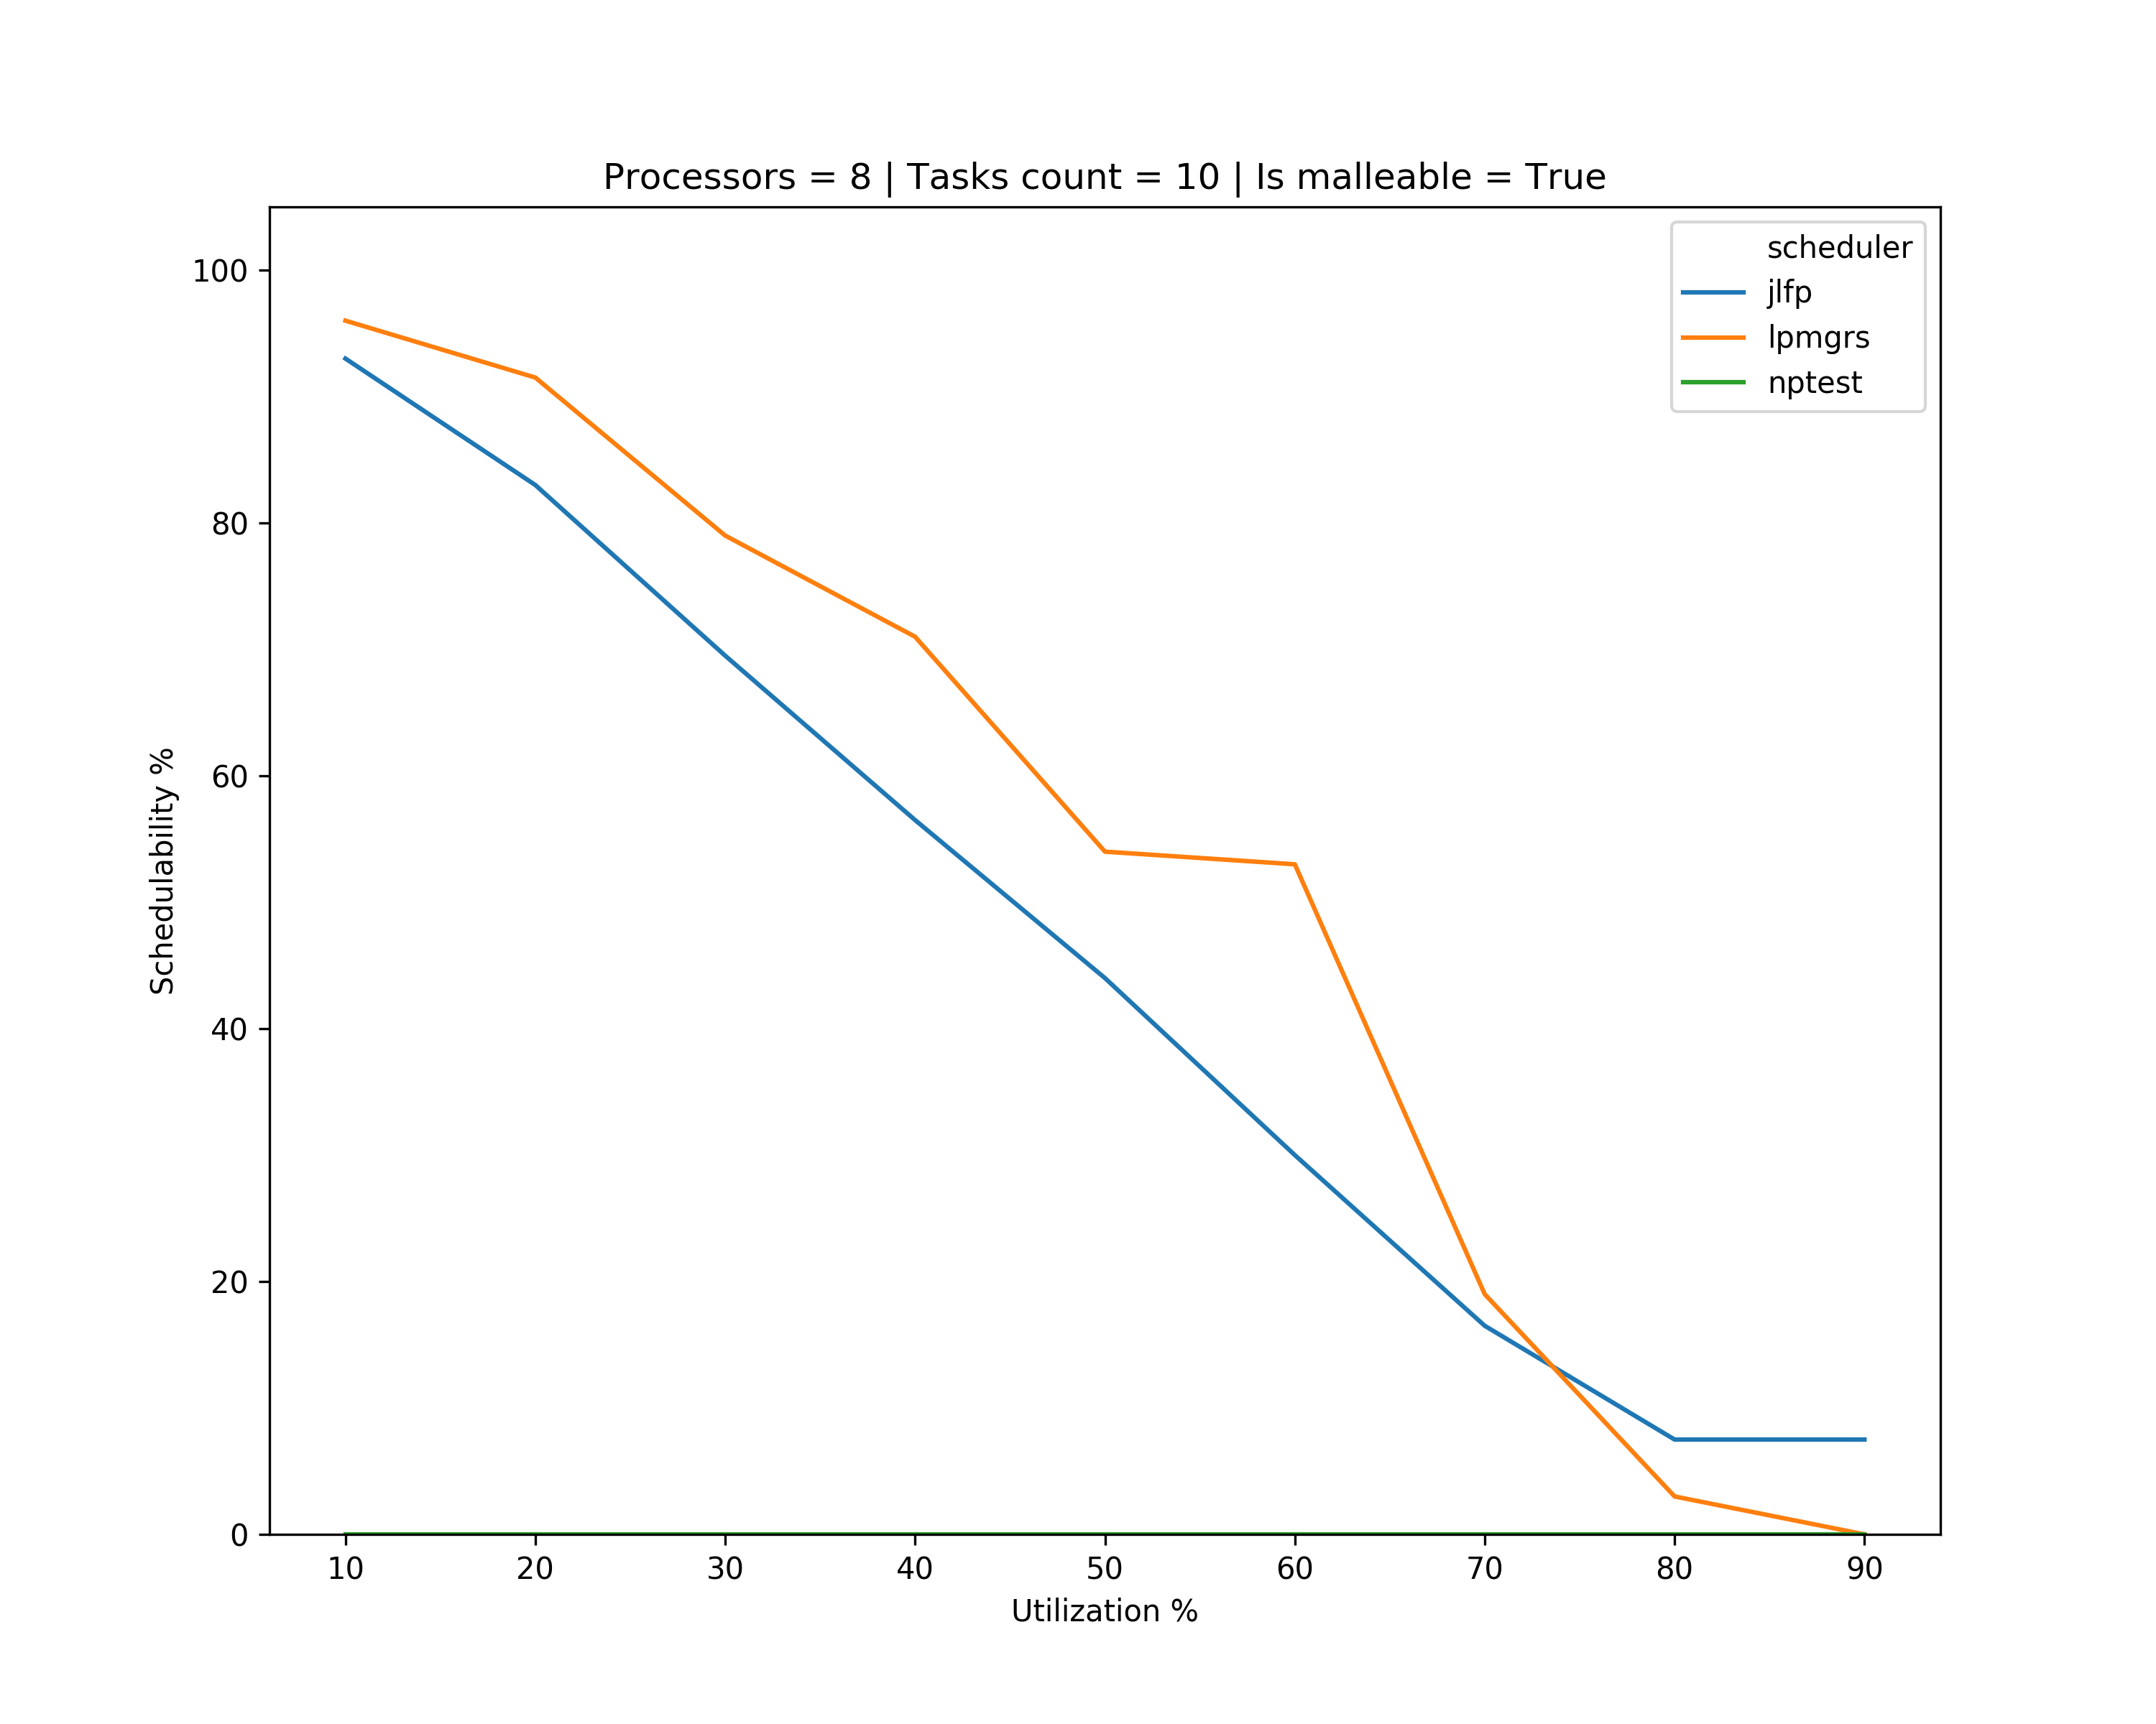
Results – single core

Slide 8
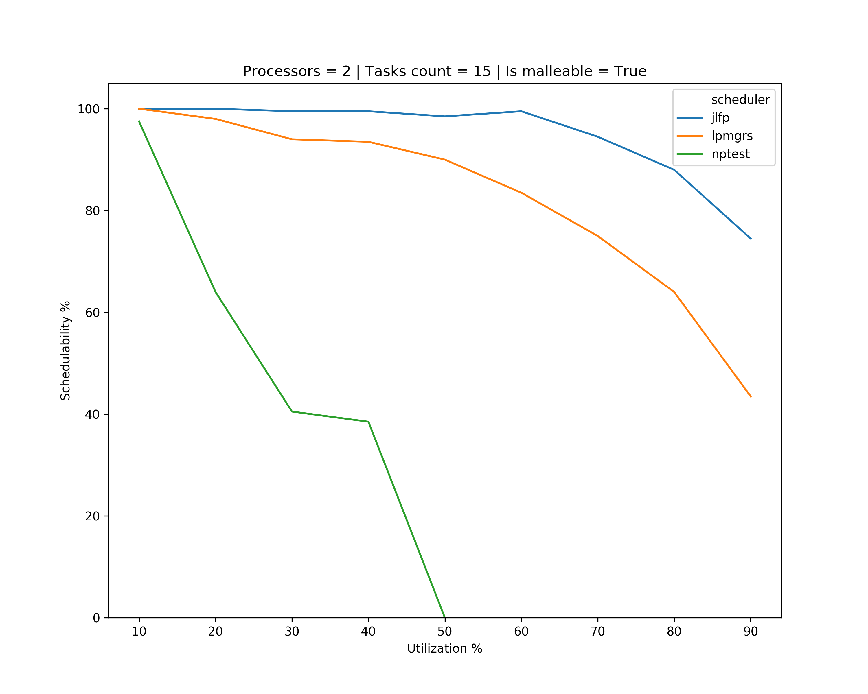
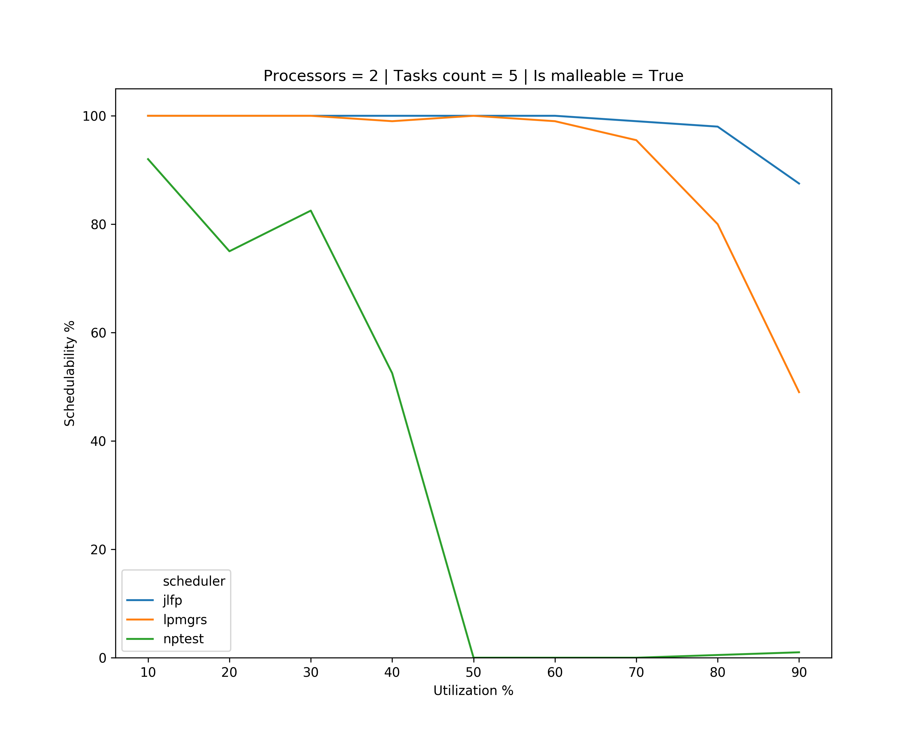
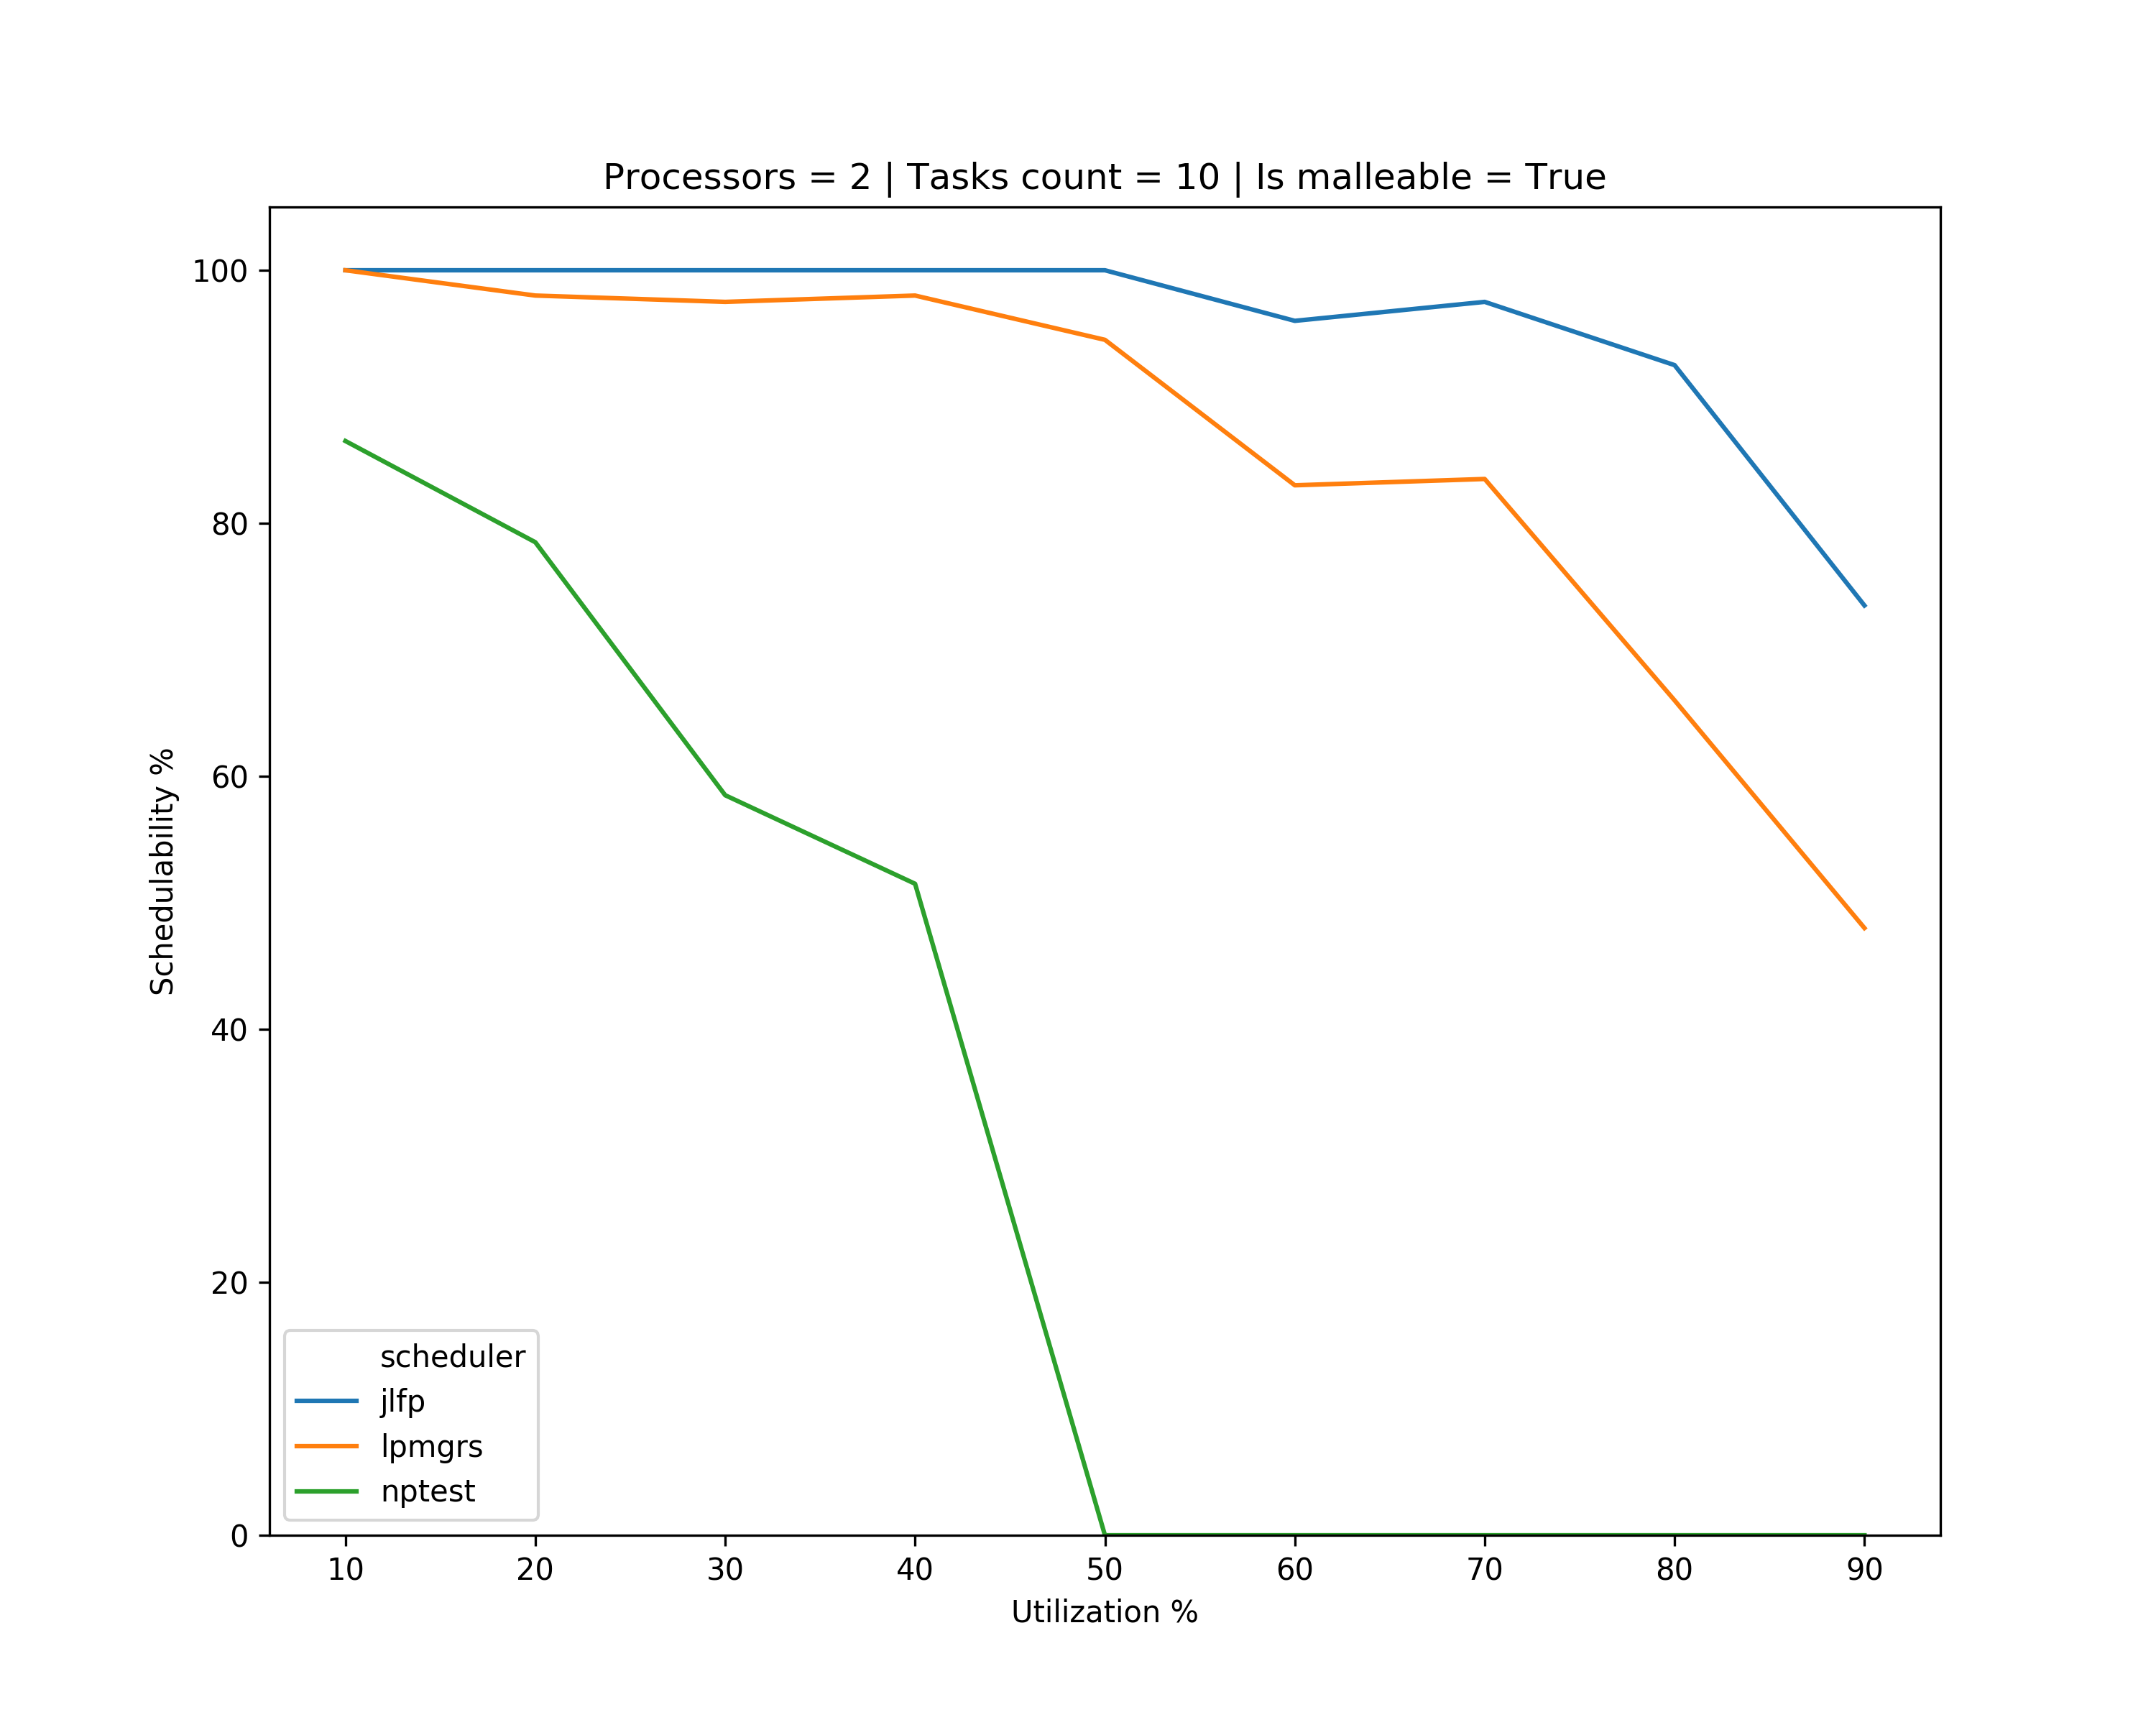
Results – minimum

Slide 9
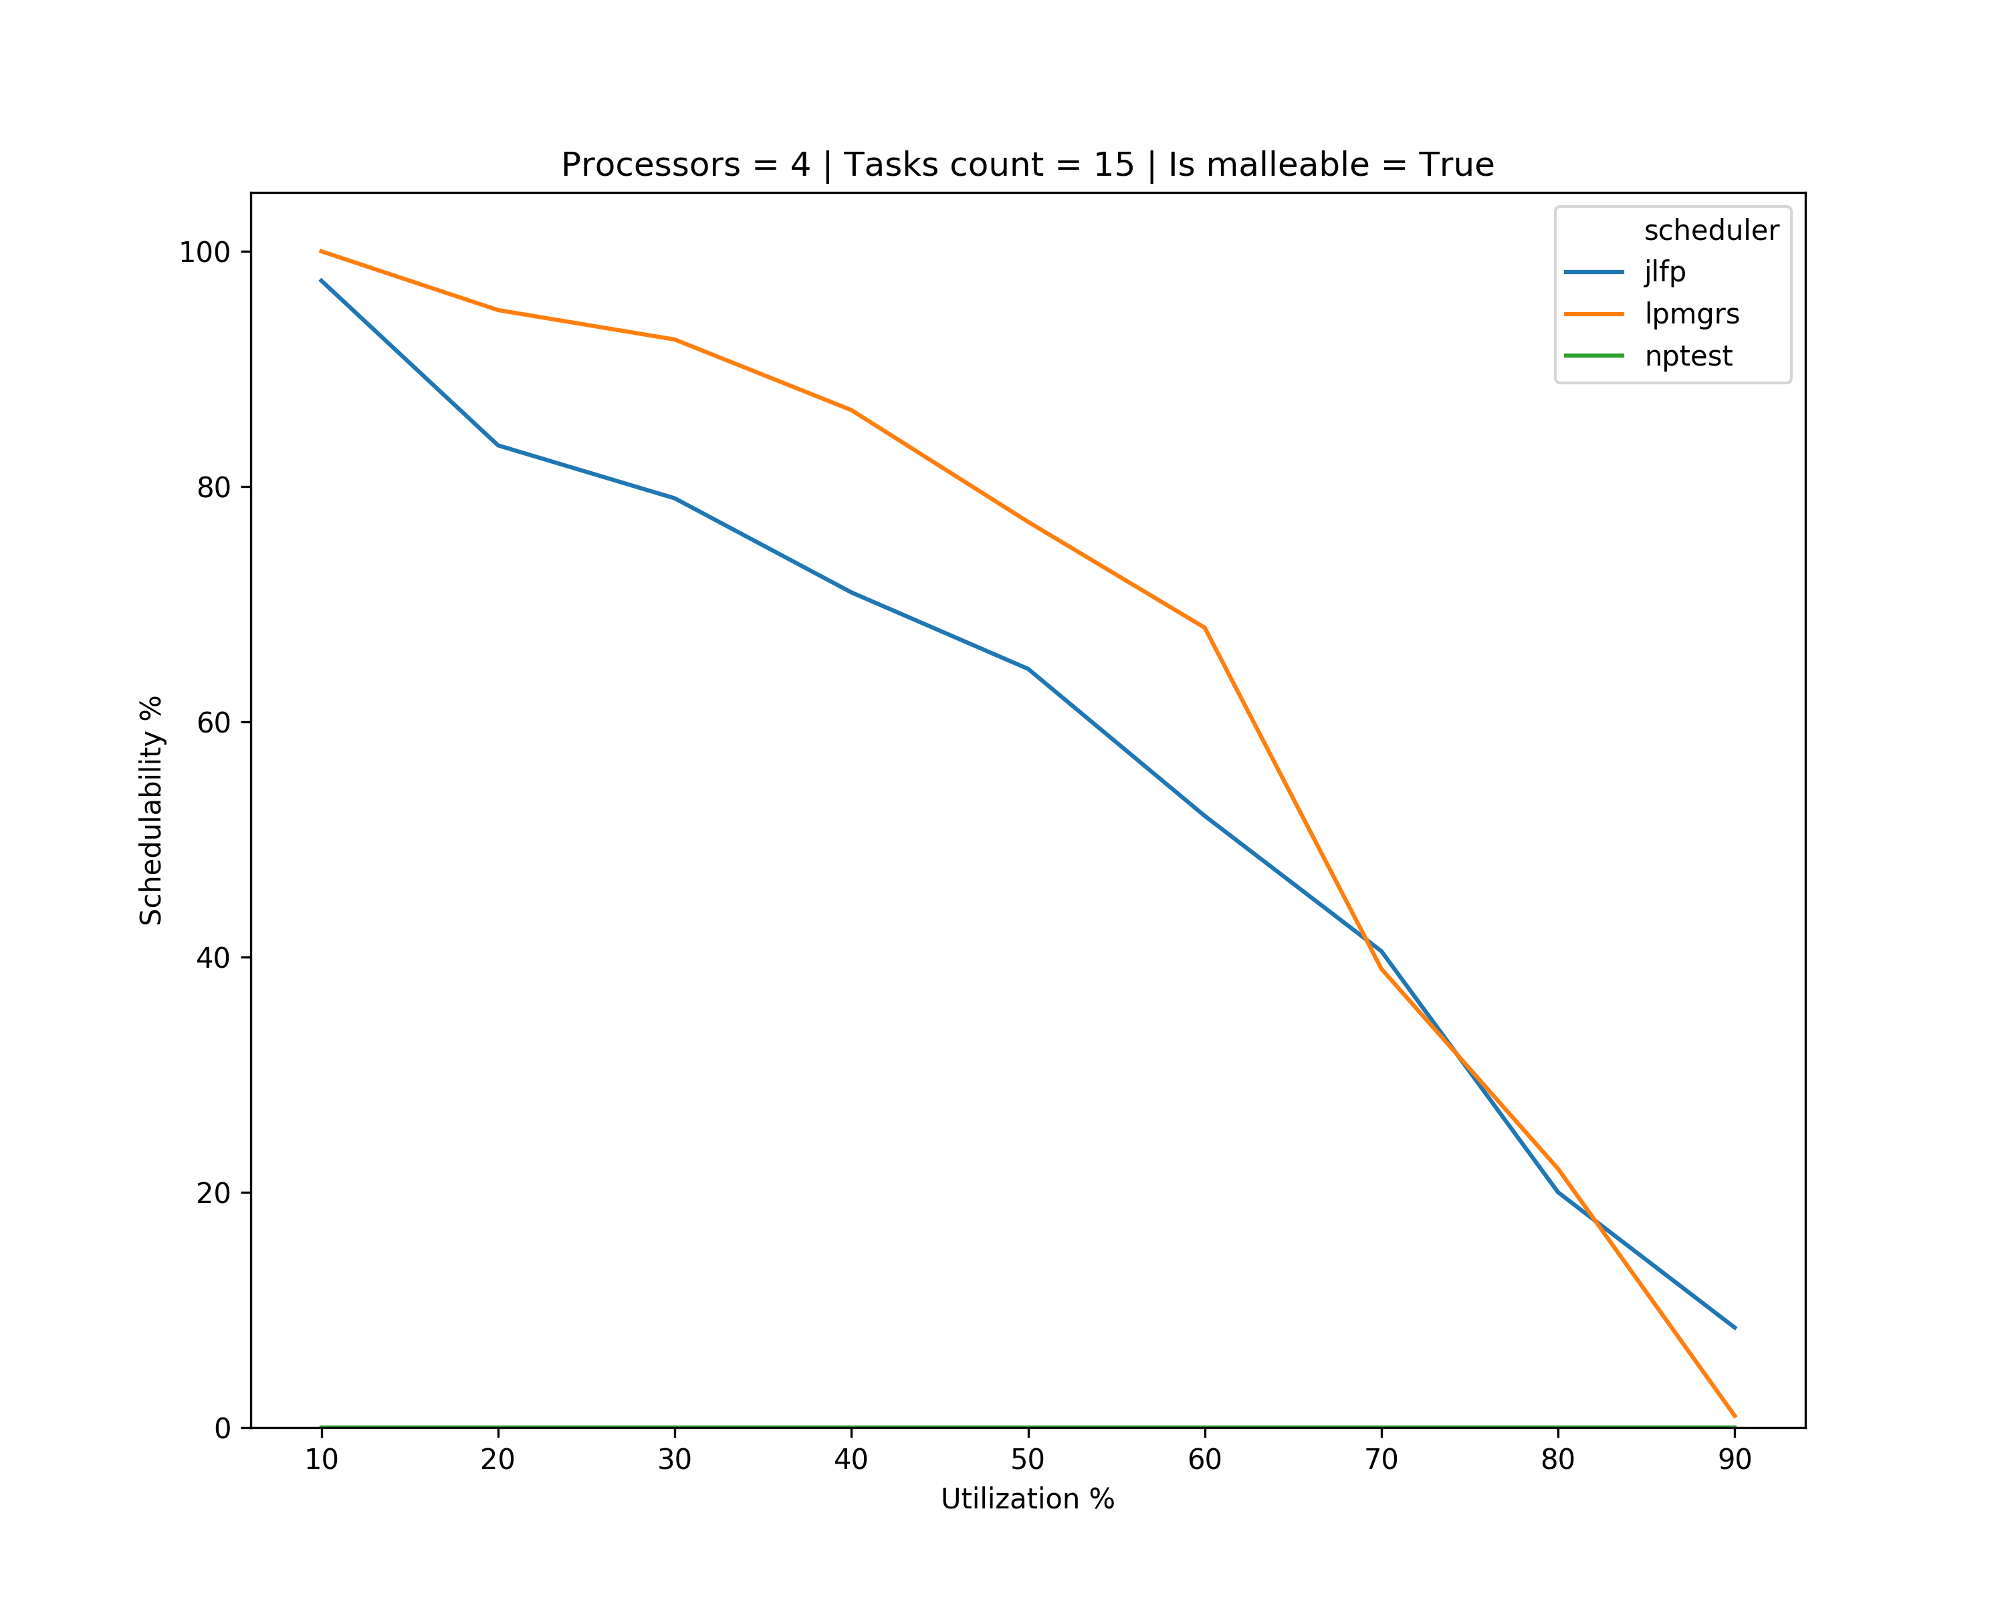
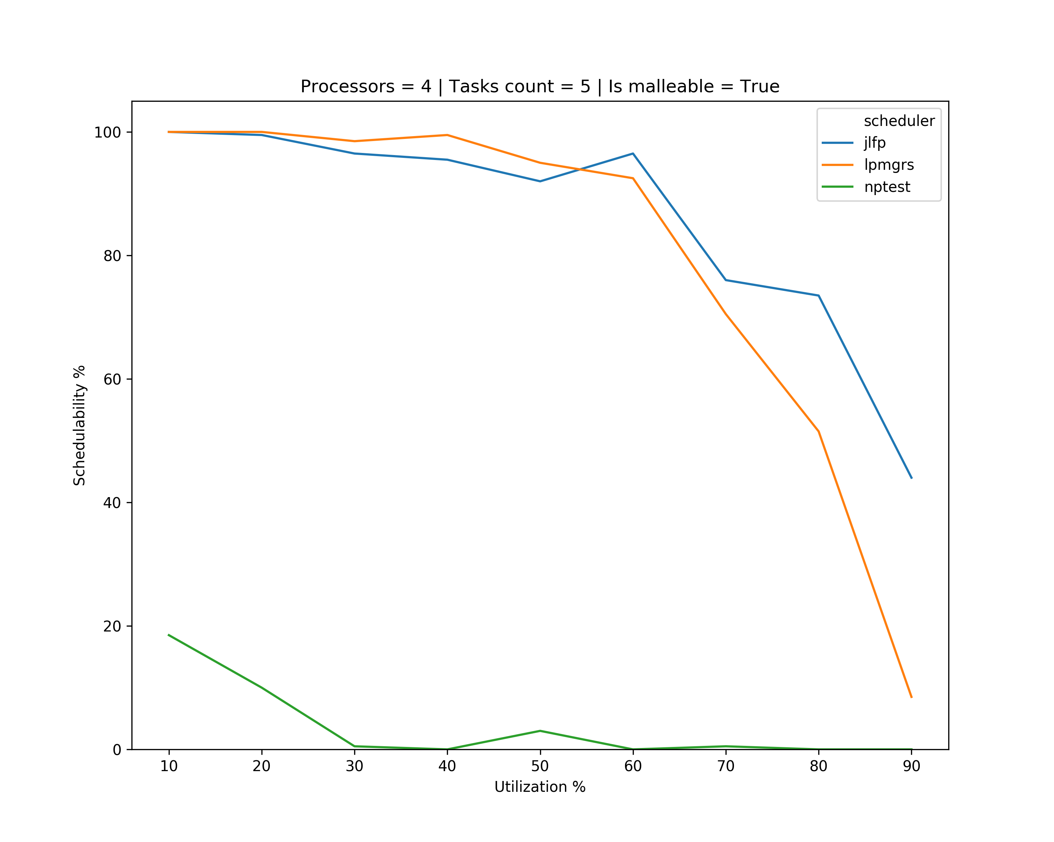
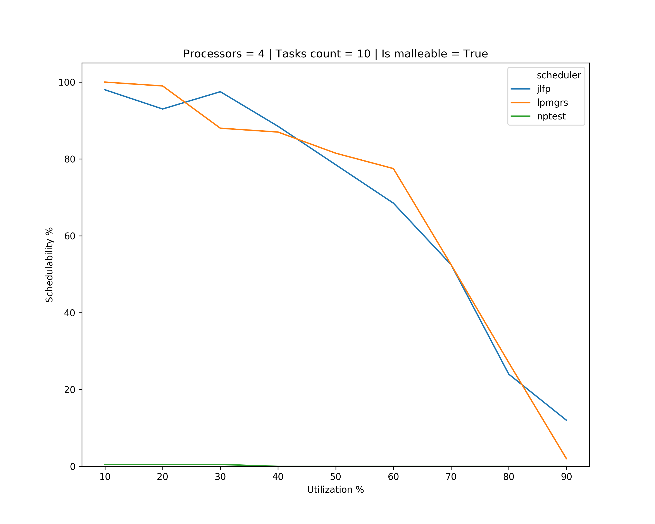
Results – minimum

Slide 10
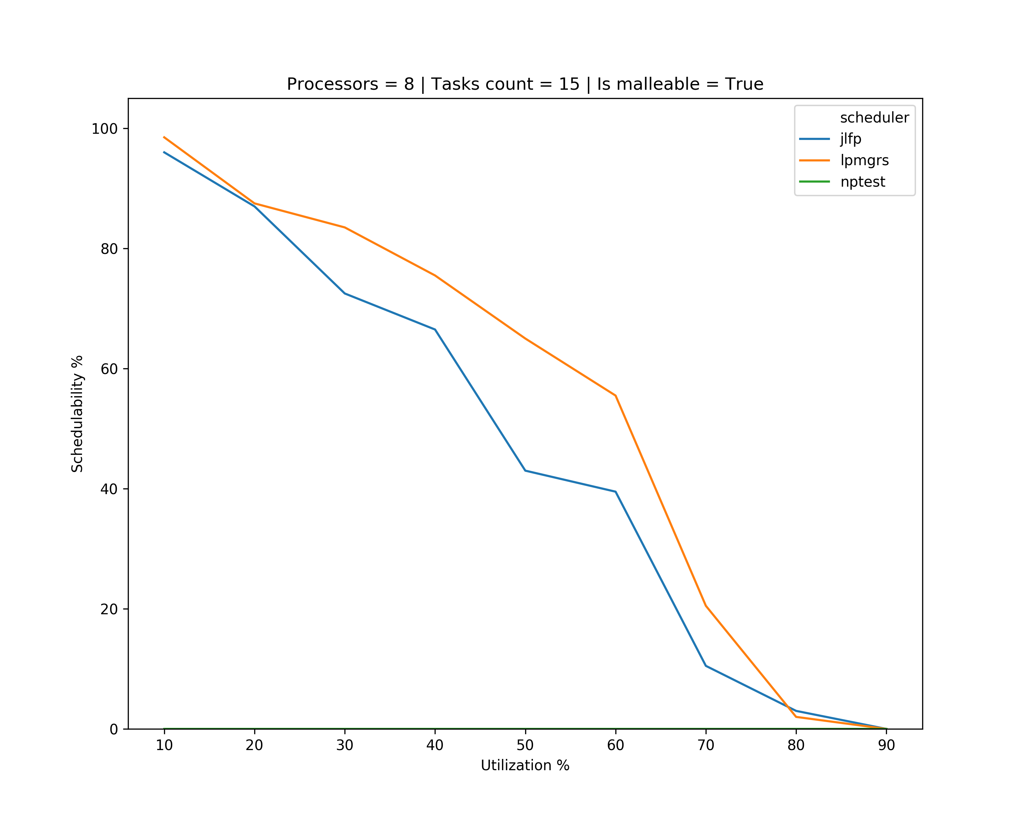
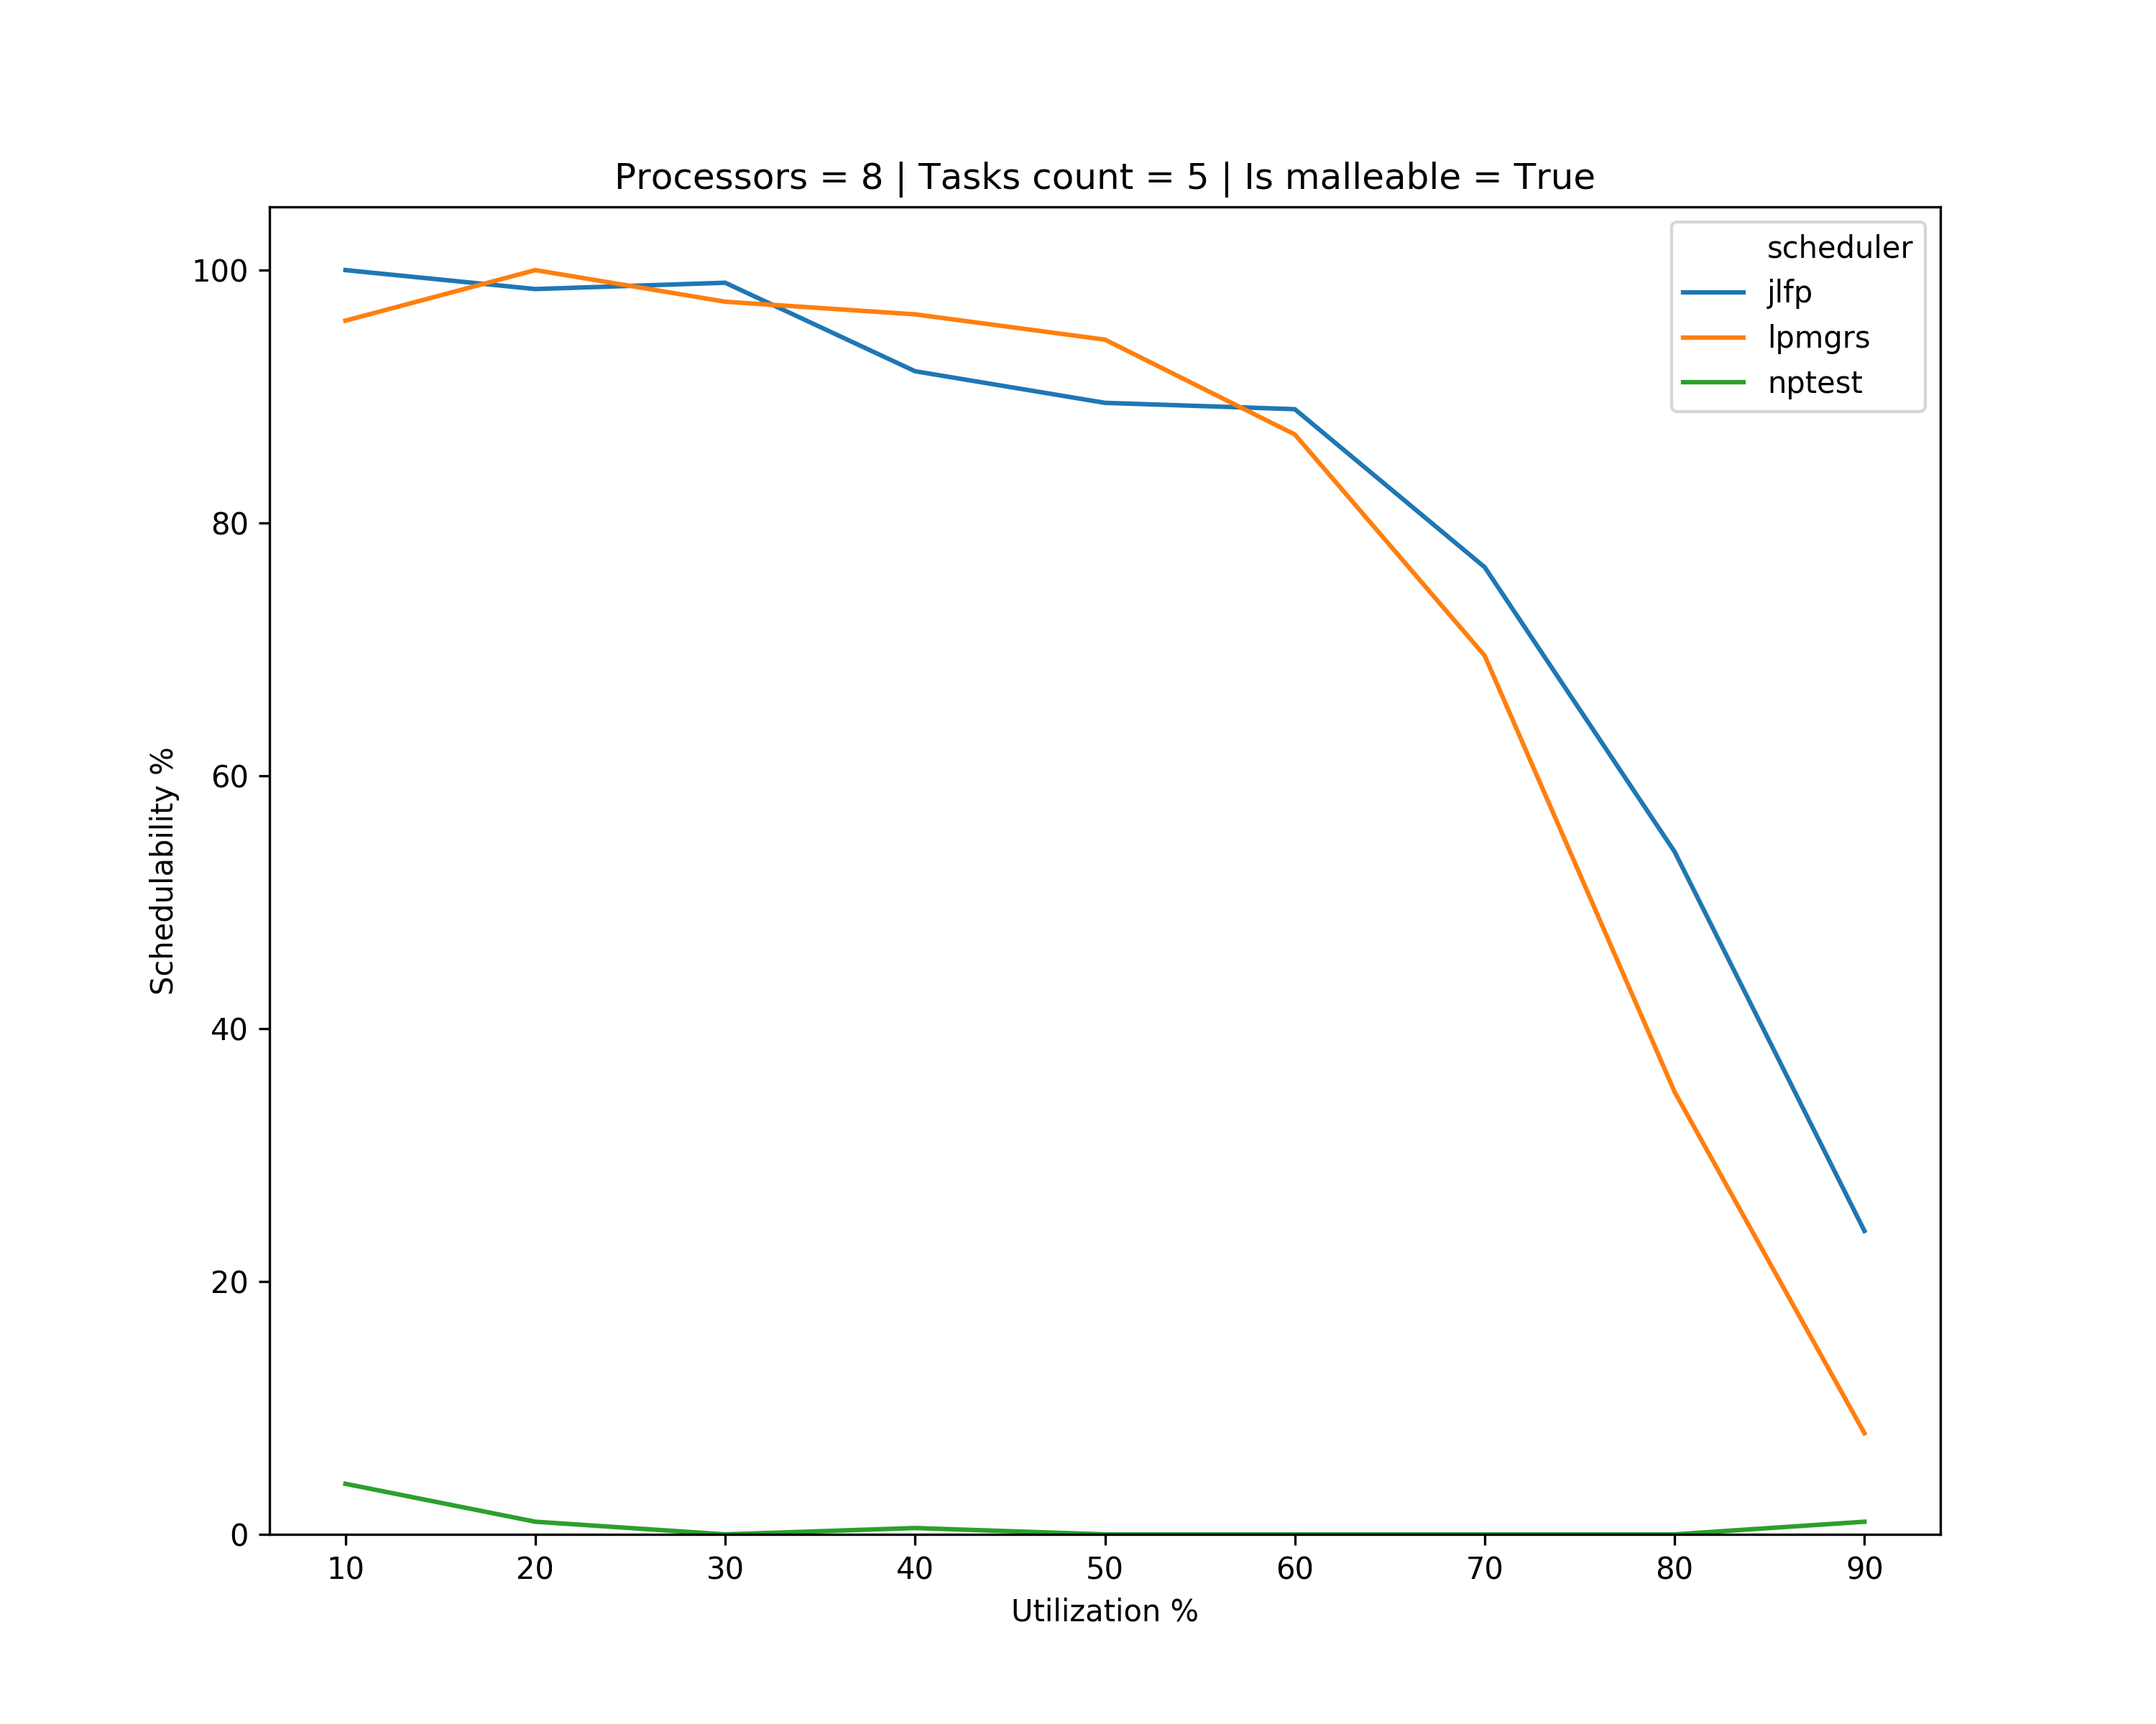
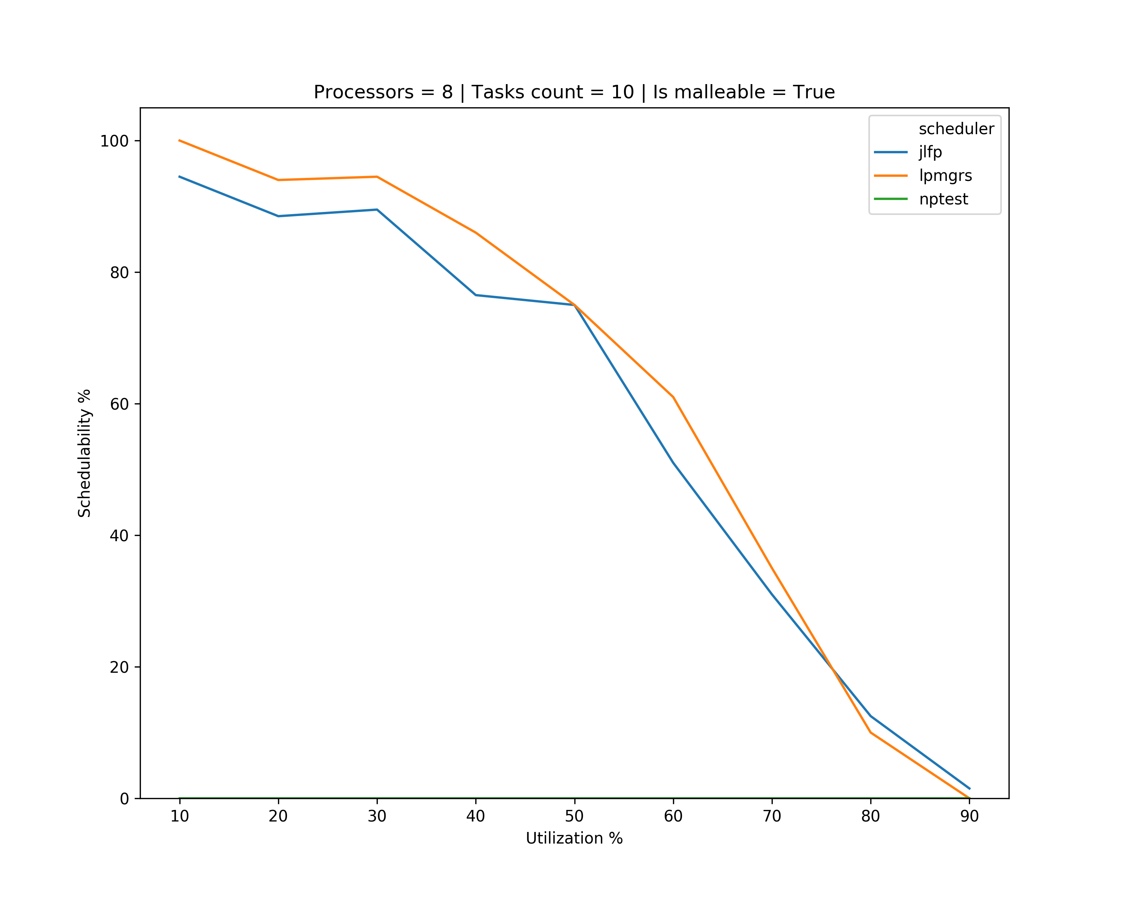
Results – minimum

Slide 11
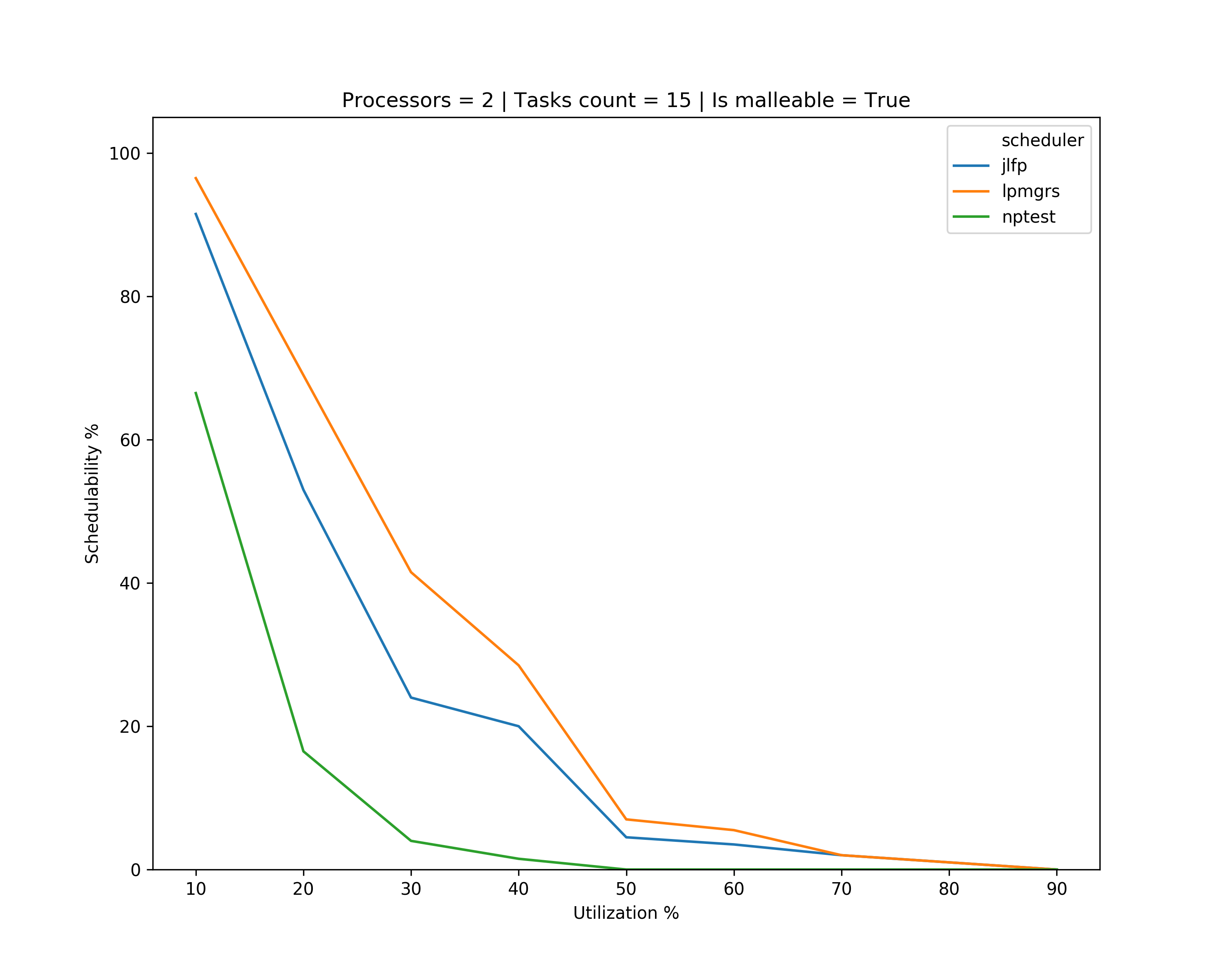
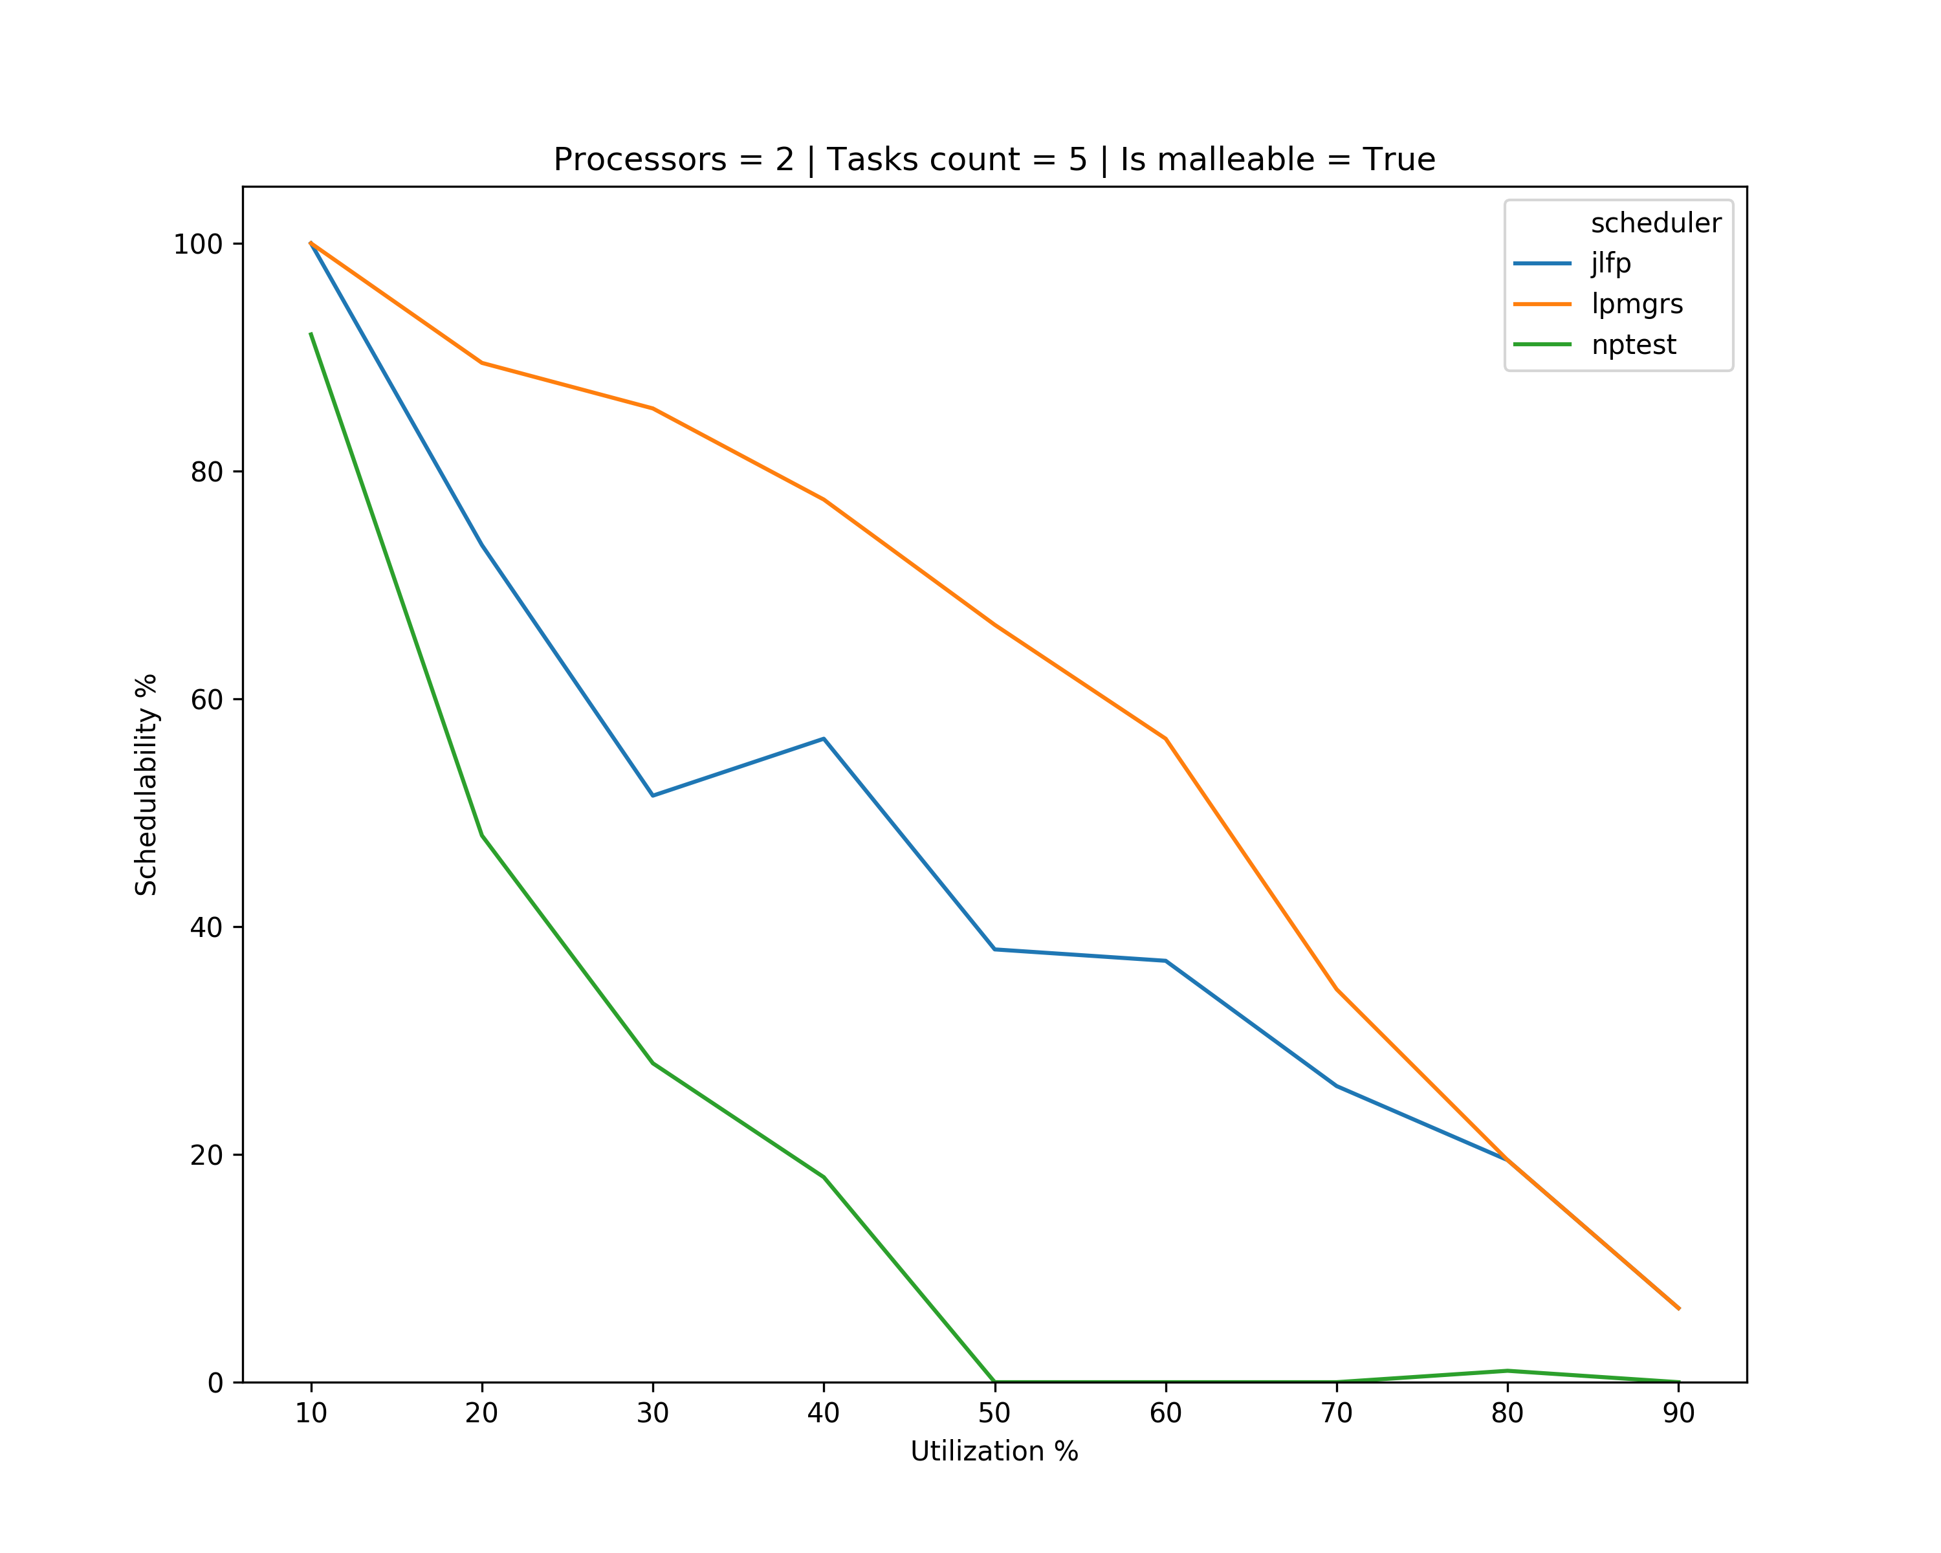
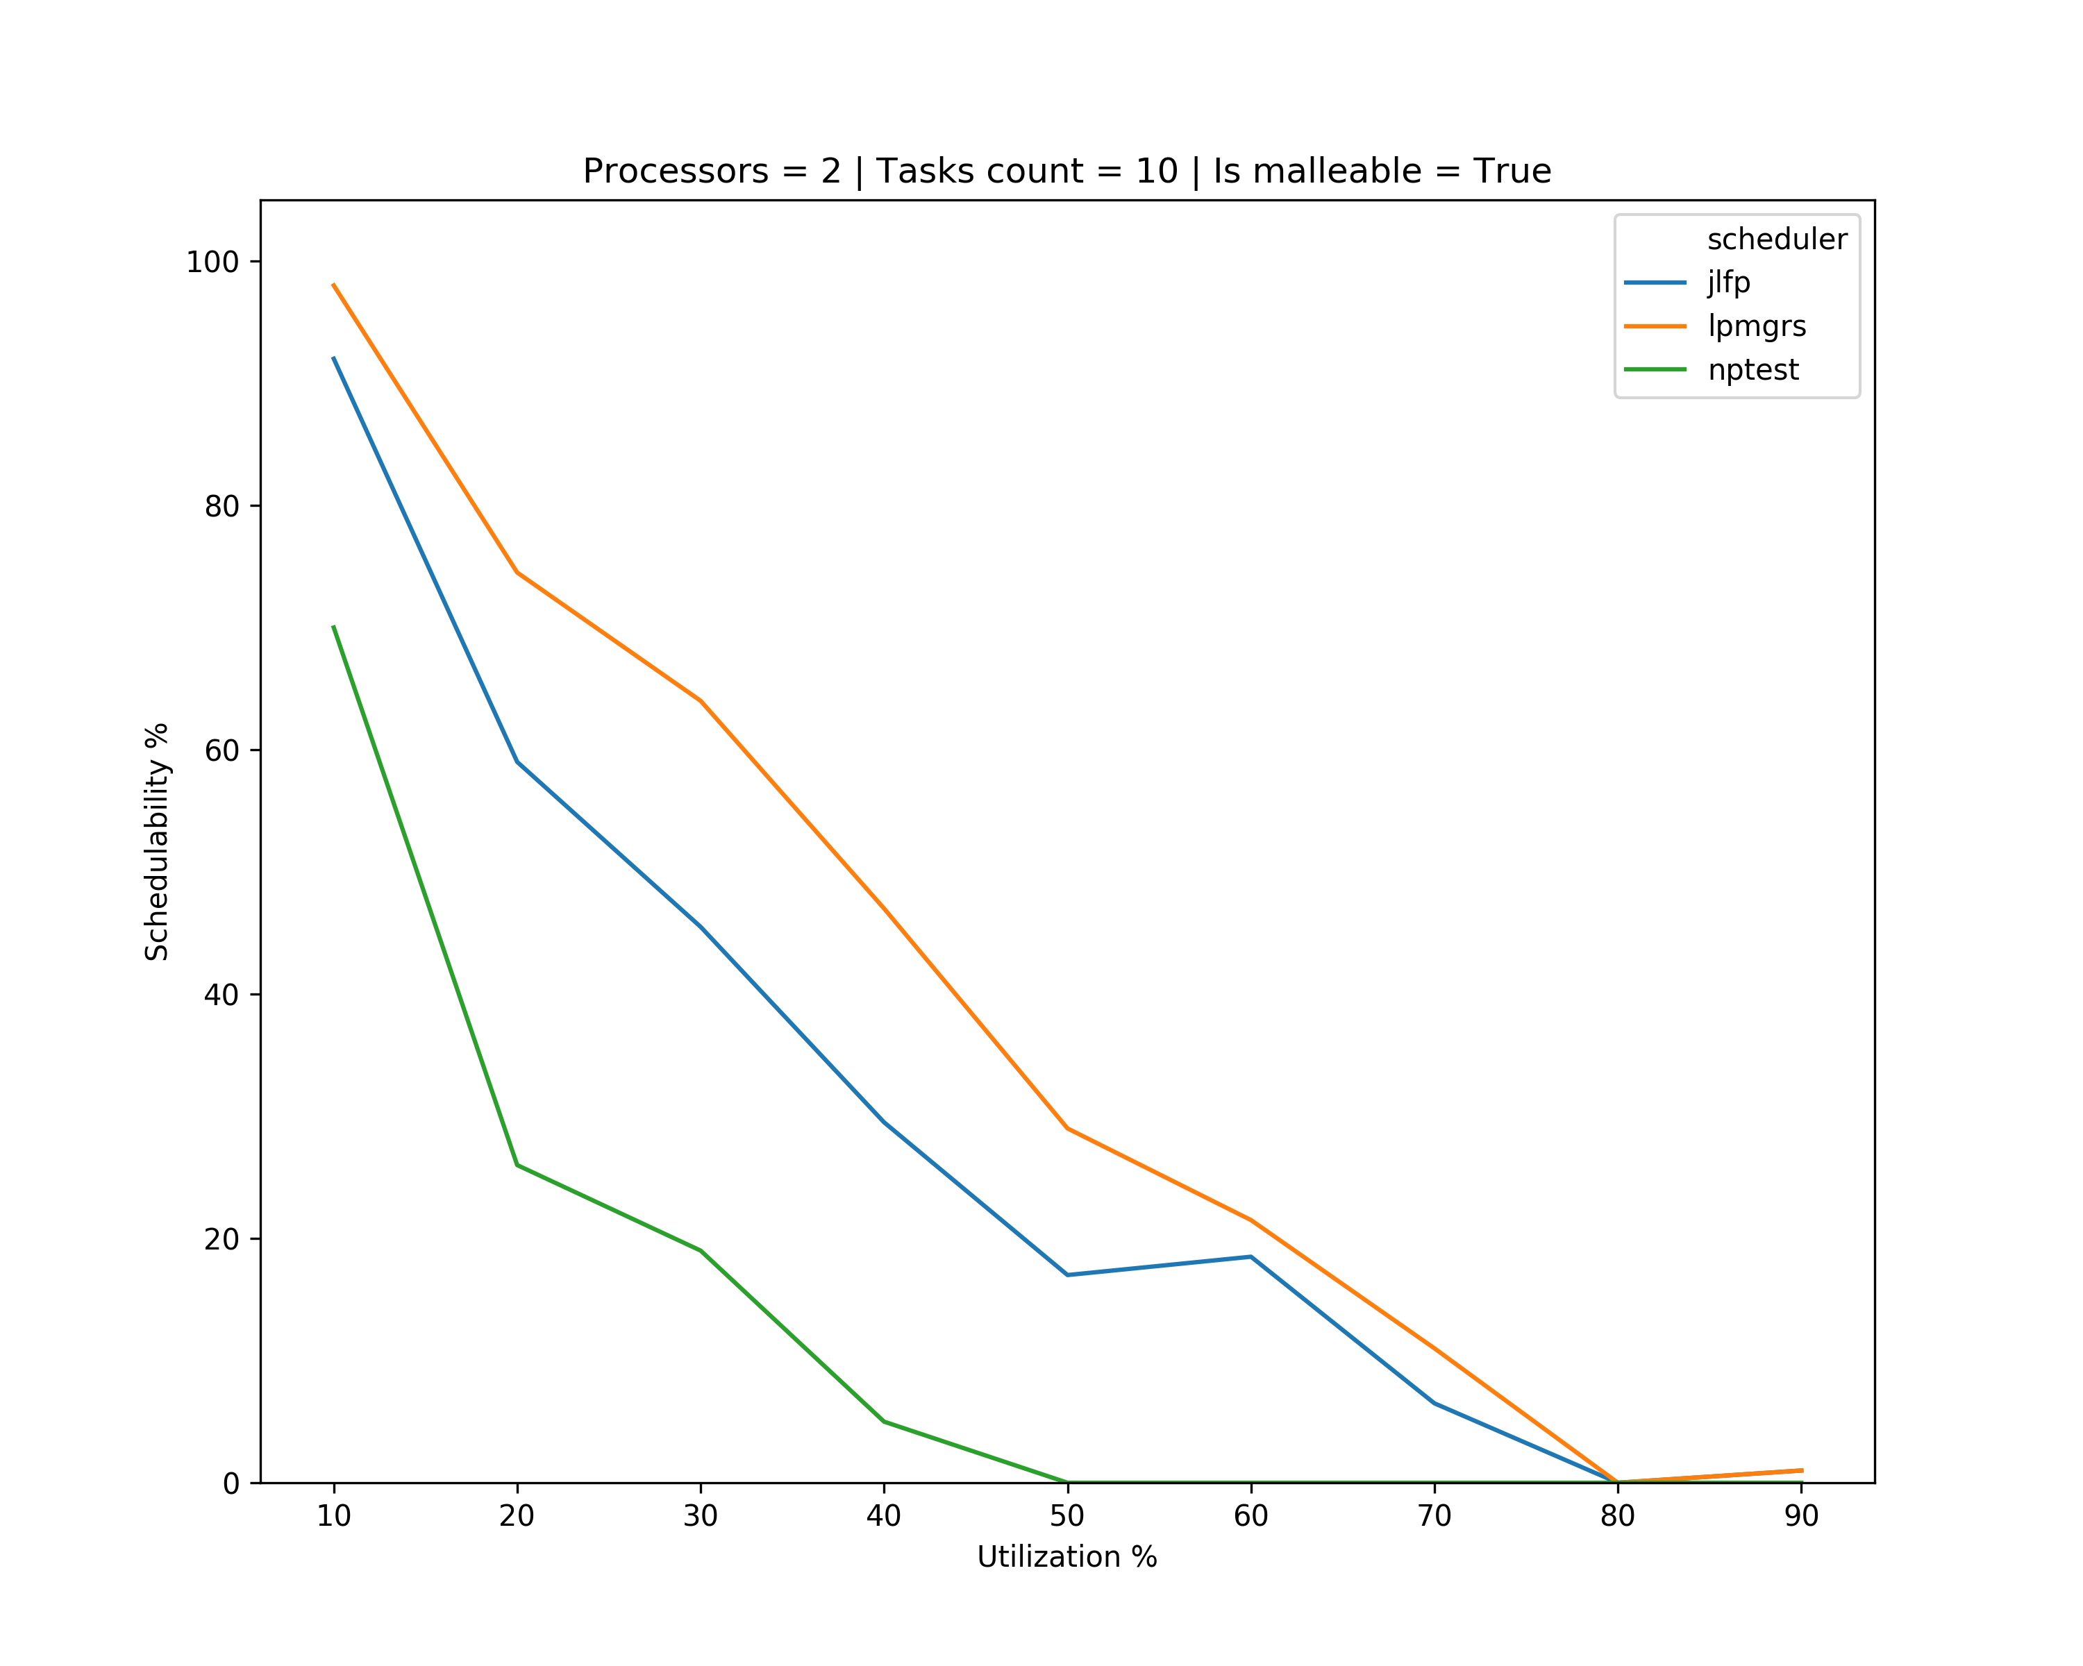
Results – multicore

Slide 12
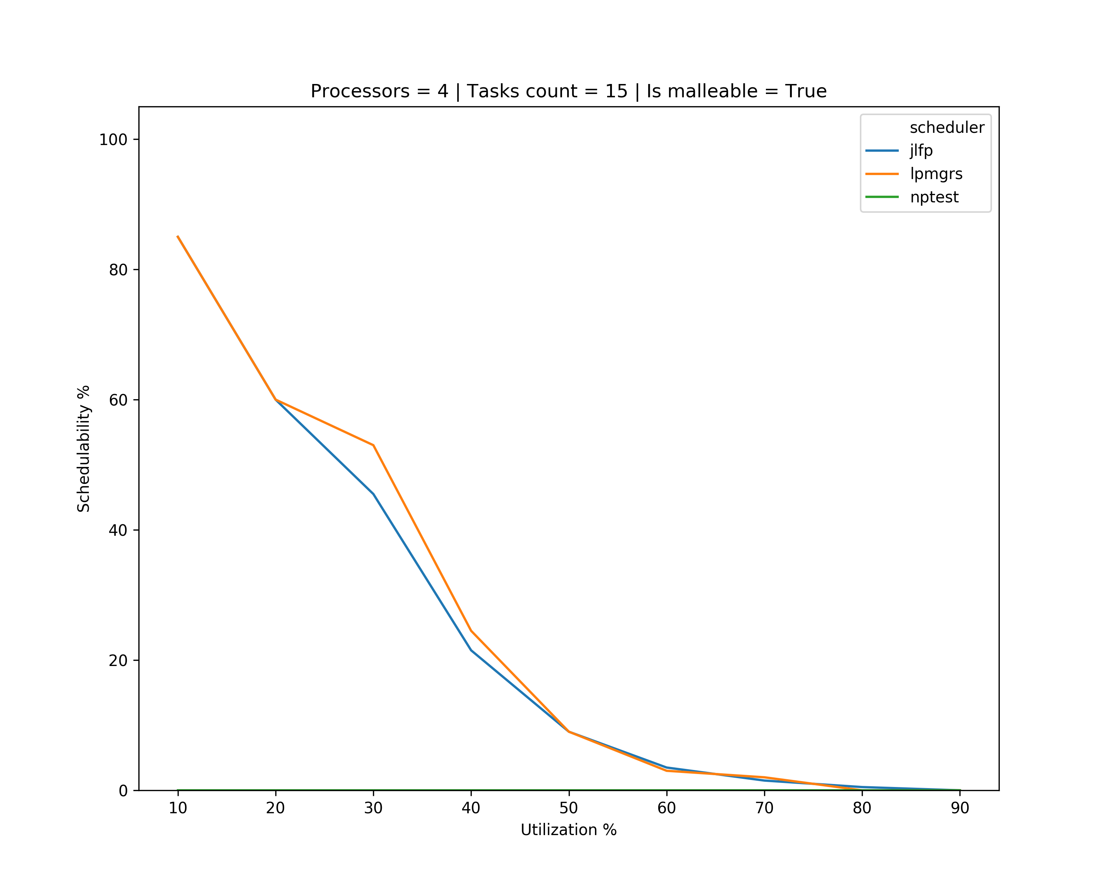
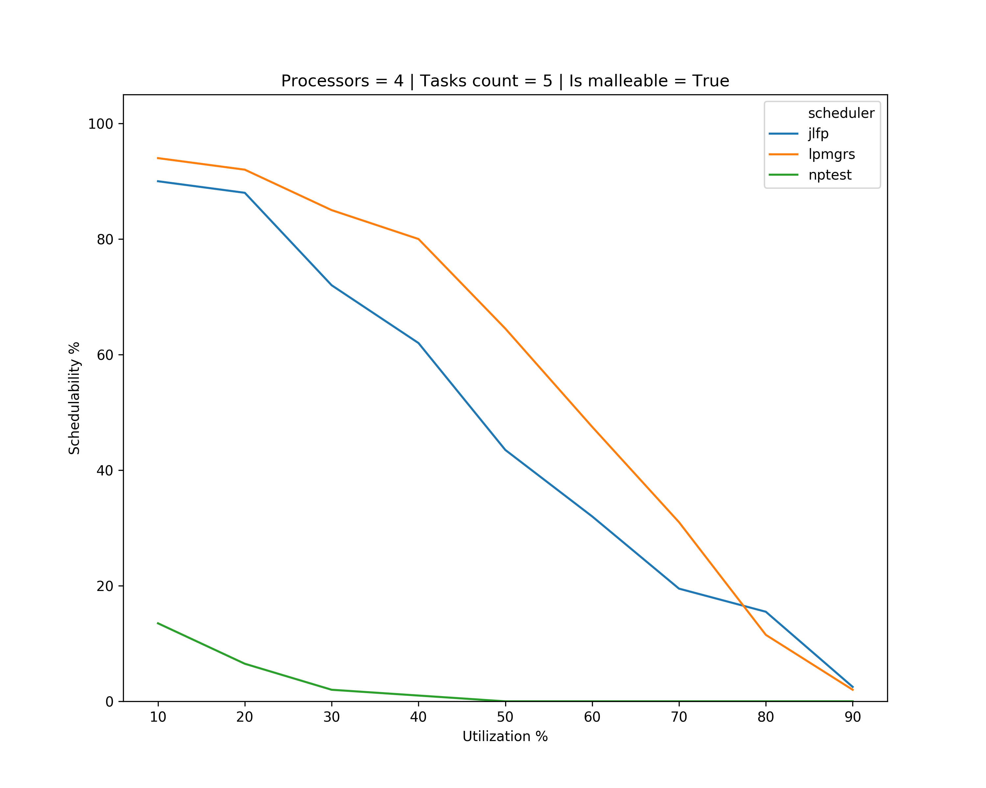
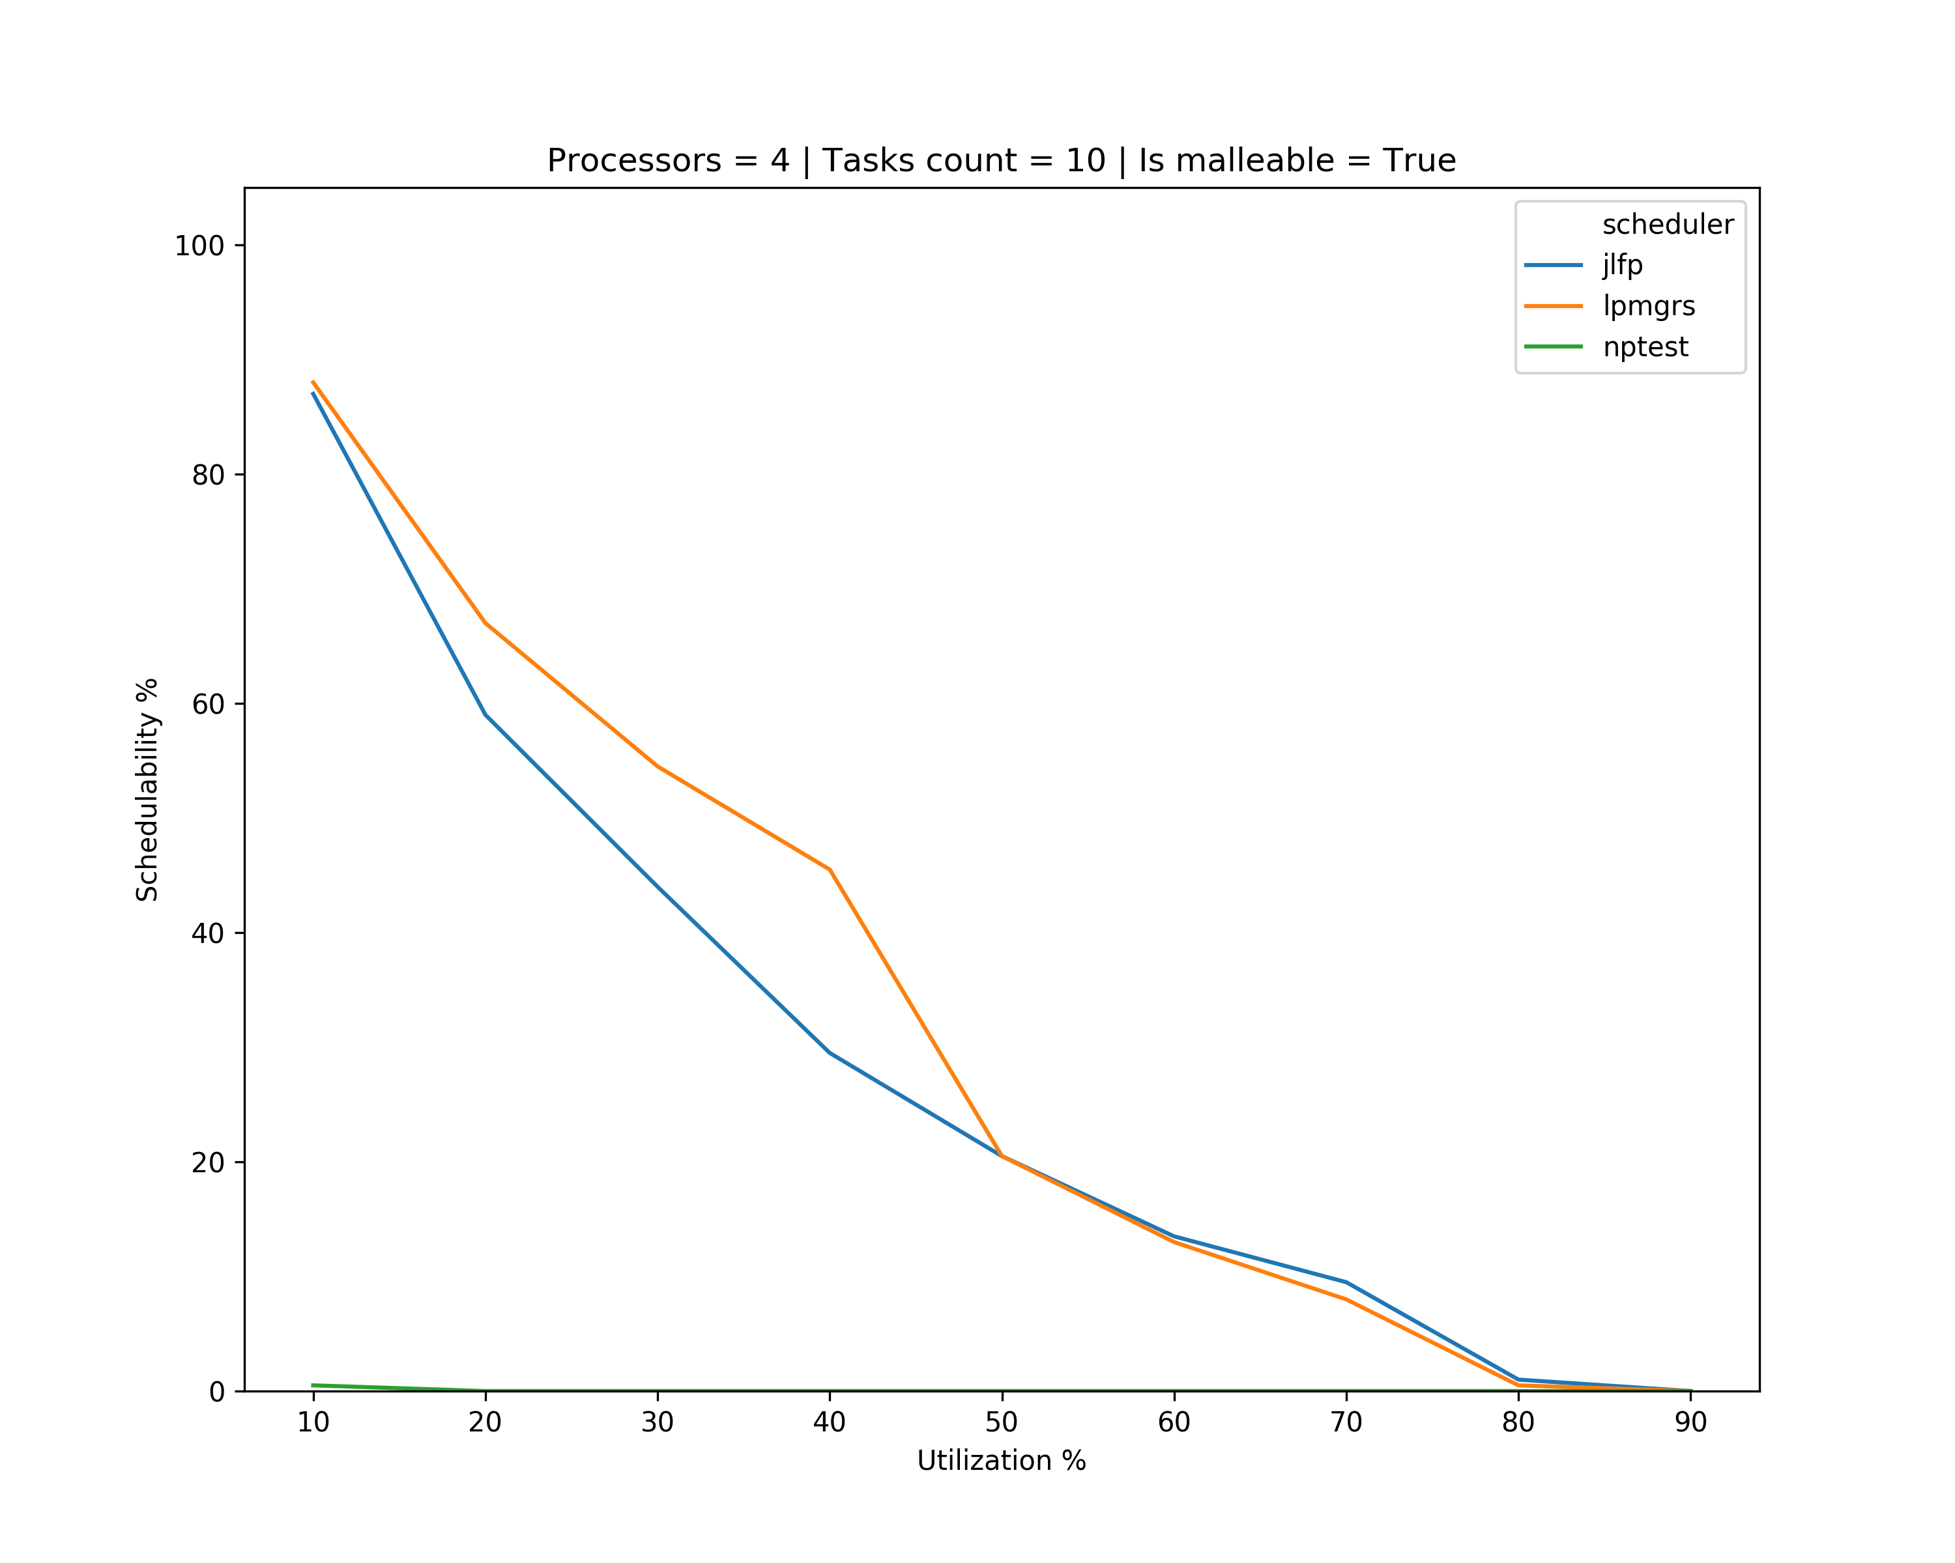
Results – multicore

Slide 13
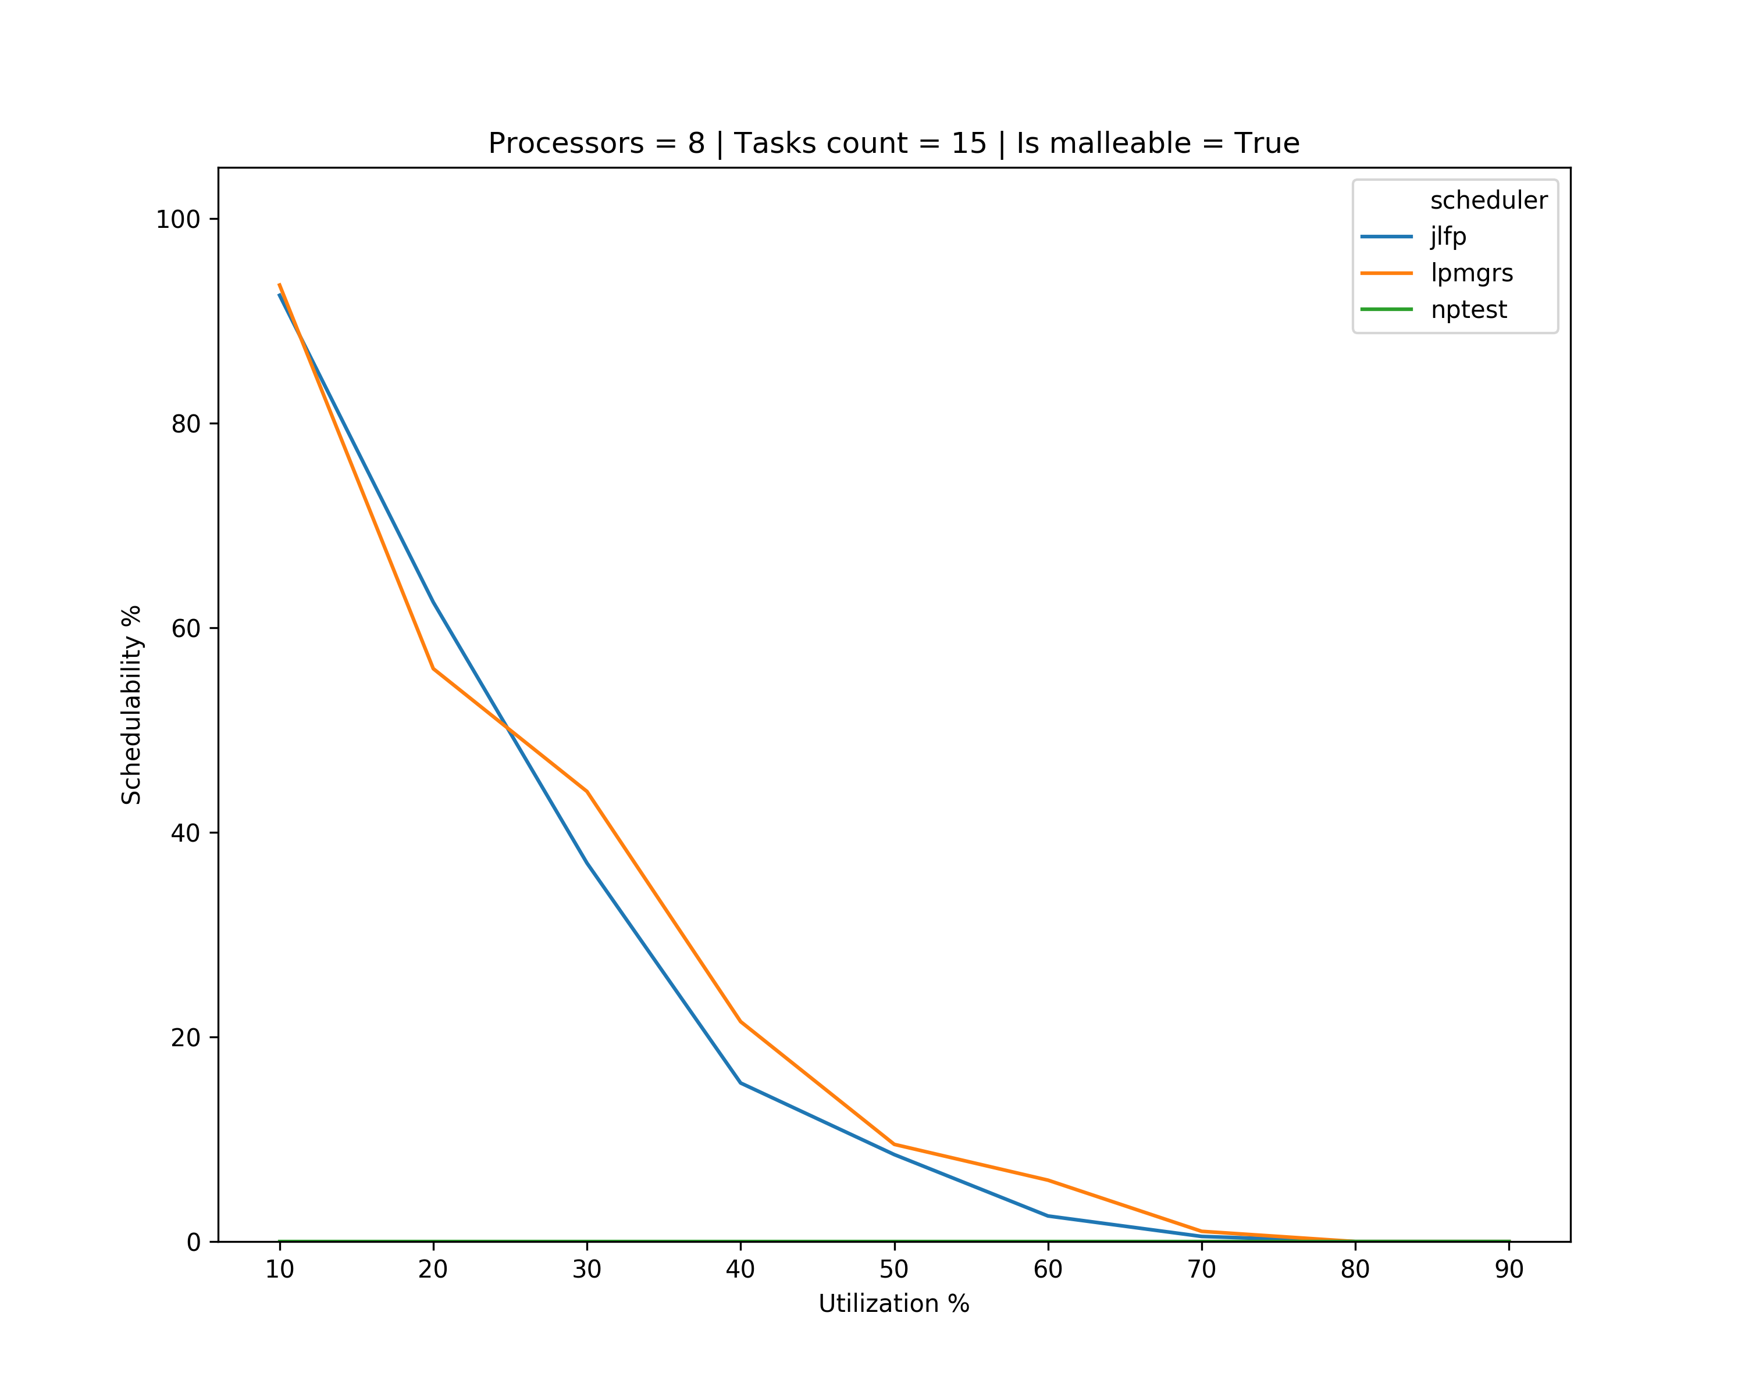
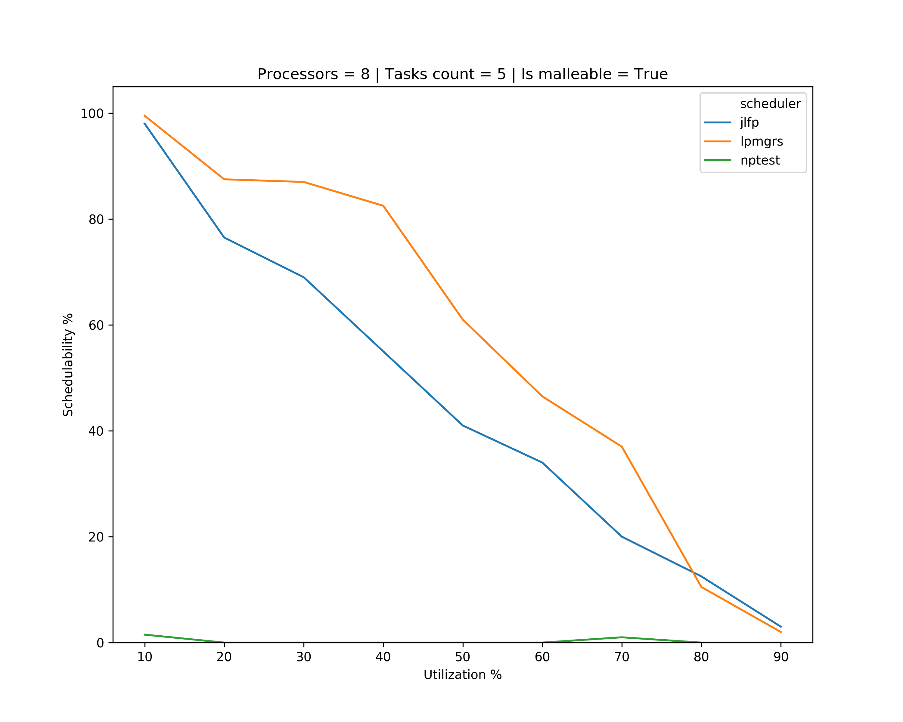
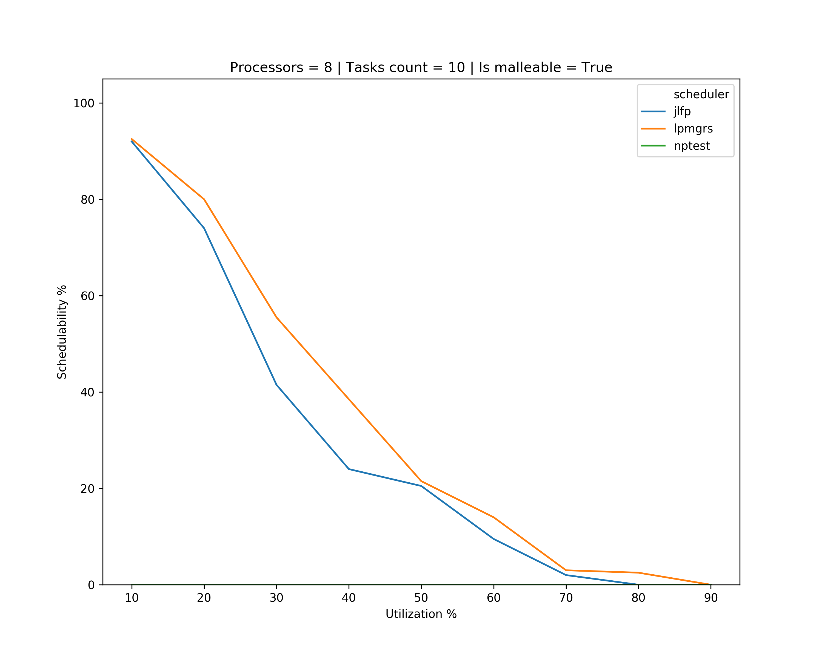
Results – multicore

Slide 14
What’s next?
Continue looking at cases for scheduling problems
Implement new version of scheduling algorithm
If it works, start working towards schedulability analysis for LPMGRS
Check what’s wrong with Schedulability Analysis
Try to be able to run schedulability analysis in multicore
Start working on generating tasks with precedence constraints

